Slide 1
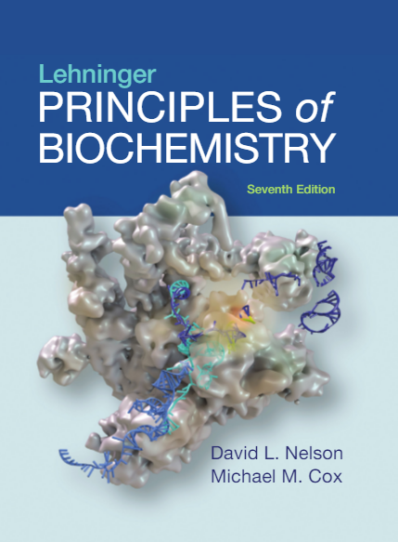
5| Protein Function
© 2017 W. H. Freeman and Company

Slide 2
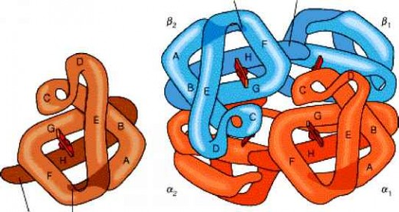
Myoglobin and Hemoglobin

Slide 3
Globins are oxygen-binding proteins
Biological problems:
Protein side chains lack affinity for O₂.
Some transition metals bind O₂ well but would generate free radicals if free in solution.
Organometallic compounds such as heme are more suitable, but Fe²⁺ in free heme could be oxidized to Fe³⁺ (very reactive!).
Biological solution:
Capture the oxygen molecule with heme that is protein bound.
Myoglobin (storage), hemoglobin (transport), leghemoglobin (soybean), … bind oxygen via a protein-bound heme.

Slide 4
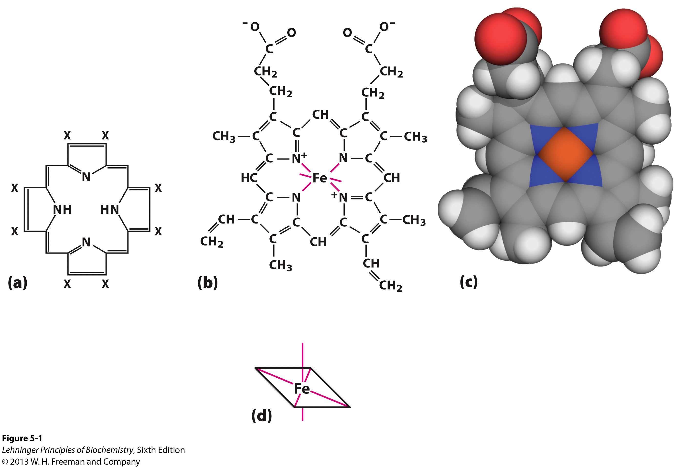
The ability of myoglobin and hemoglobin to bind oxygen depends on the heme group
Notes:
The heme group consists of an organic component called protoporphyrin and a central iron ion in the ferrous (Fe²⁺) form, the only form that can bind oxygen.
The iron lies in the middle of the protoporphyrin bound to four nitrogens.
Iron can form two additional bonds, at the fifth and sixth coordination sites.
The fifth coordination site is occupied by an imidazole ring of a histidine called the proximal histidine.
The sixth coordination site binds oxygen.

Slide 5
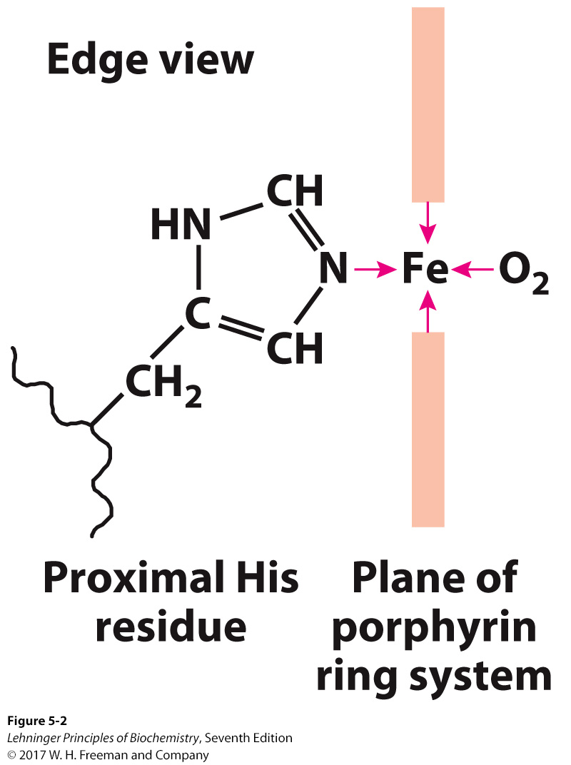
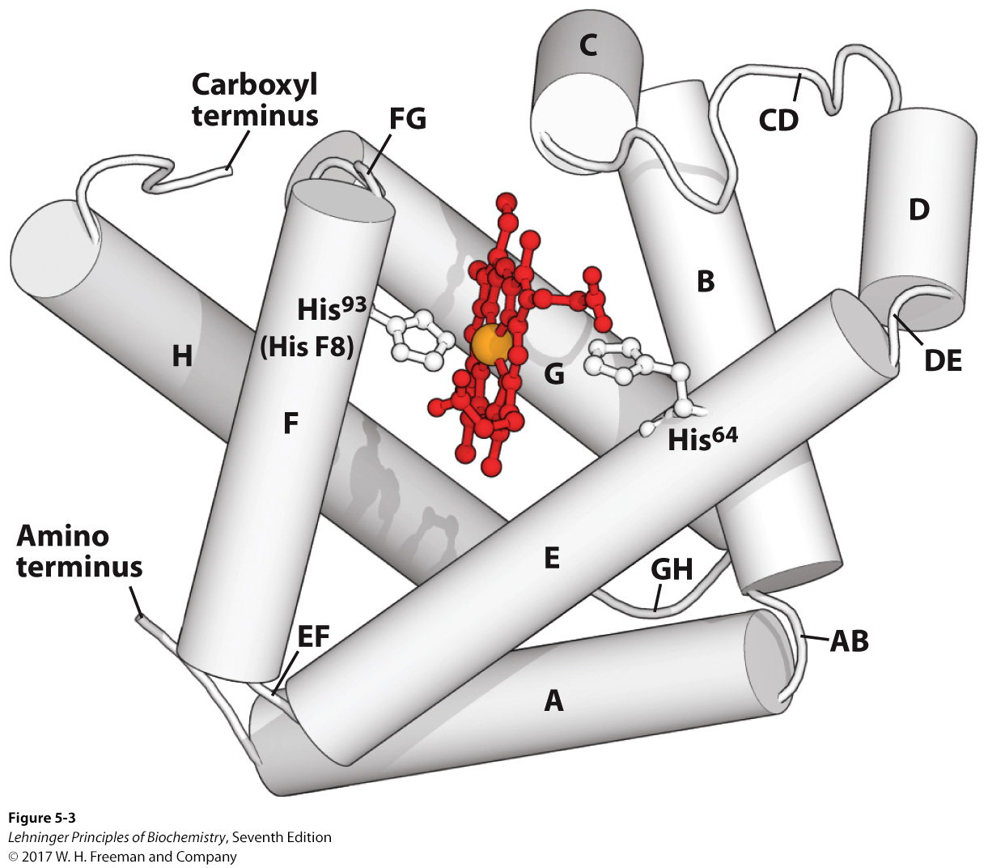
Structure of Myoglobin
Notes:
FIGURE 5–2 The heme group viewed from the side. This view shows the two coordination bonds to Fe²⁺ that are perpendicular to the porphyrin ring system. One is occupied by a His residue, sometimes called the proximal His; the other is the binding site for oxygen. The remaining four coordination bonds are in the plane of, and bonded to, the flat porphyrin ring system.
FIGURE 5–3 Myoglobin. (PDB ID 1MBO) The eight α-helical segments (shown here as cylinders) are labeled A through H. Nonhelical residues in the bends that connect them are labeled AB, CD, EF, and so forth, indicating the segments they interconnect. A few bends, including BC and DE, are abrupt and do not contain any residues; these are not normally labeled. (The short segment visible between D and E is an artifact of the computer representation.) The heme is bound in a pocket made up largely of the E and F helices, although amino acid residues from other segments of the protein also participate.

Slide 6
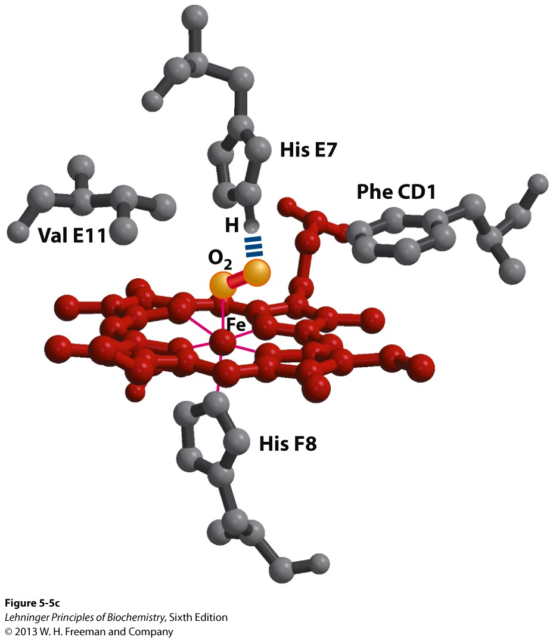
Oxygen binding to myoglobin
His⁹³ (His F8, the proximal histidine) binds to Fe²⁺ in heme
The axis of the oxygen molecule is positioned at an angle to the Fe-O bond
His⁶⁴ (His E7, the distal histidine) forms a hydrogen bond with O₂
This may help preclude the linear binding of CO, providing one explanation for the diminished binding of CO to heme in myoglobin and hemoglobin.
Notes:
The binding of O₂ to heme in Mb depends on molecular motions (“breathing”) of the structure: in order for O₂ to reach its binding site in heme, side-chains of Mb must move out of the way and produce transient cavities in the structure through which O₂ can move

Slide 7
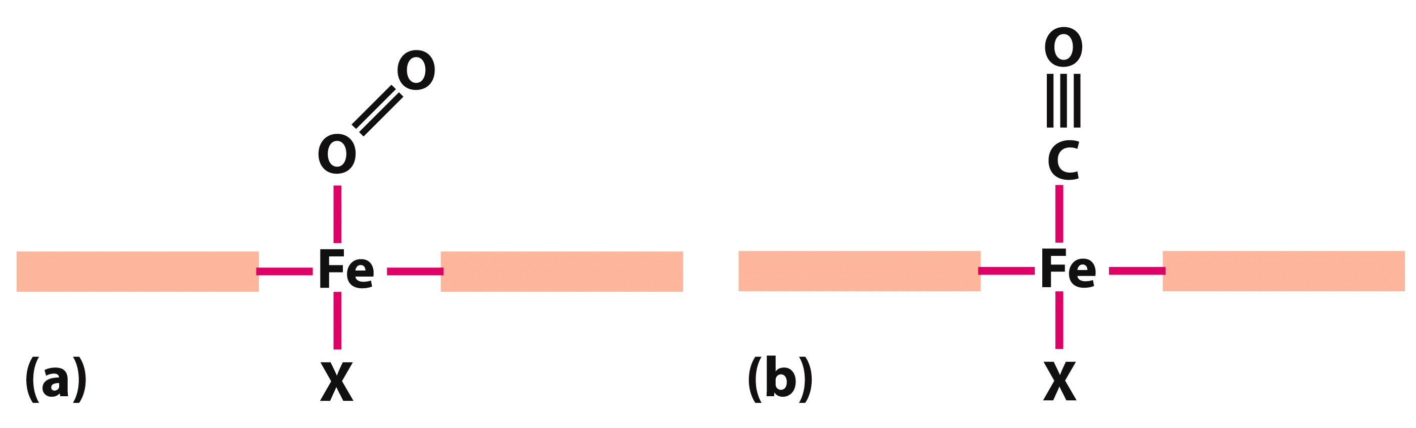
Protein structure affect how ligands bind
CO binds to free heme molecules more than 20,000 times better than O₂ (that is the K_{d} or P₅₀ for CO binding to free heme is more than 20,000 times lower than that for O₂).
However, CO only binds about 200 times better than O₂ when the heme is bound to Mb.
This difference can be partly explained by steric hindrance. When CO binds to free heme, the Fe, C, and O atoms lie in a straight line.

Slide 8
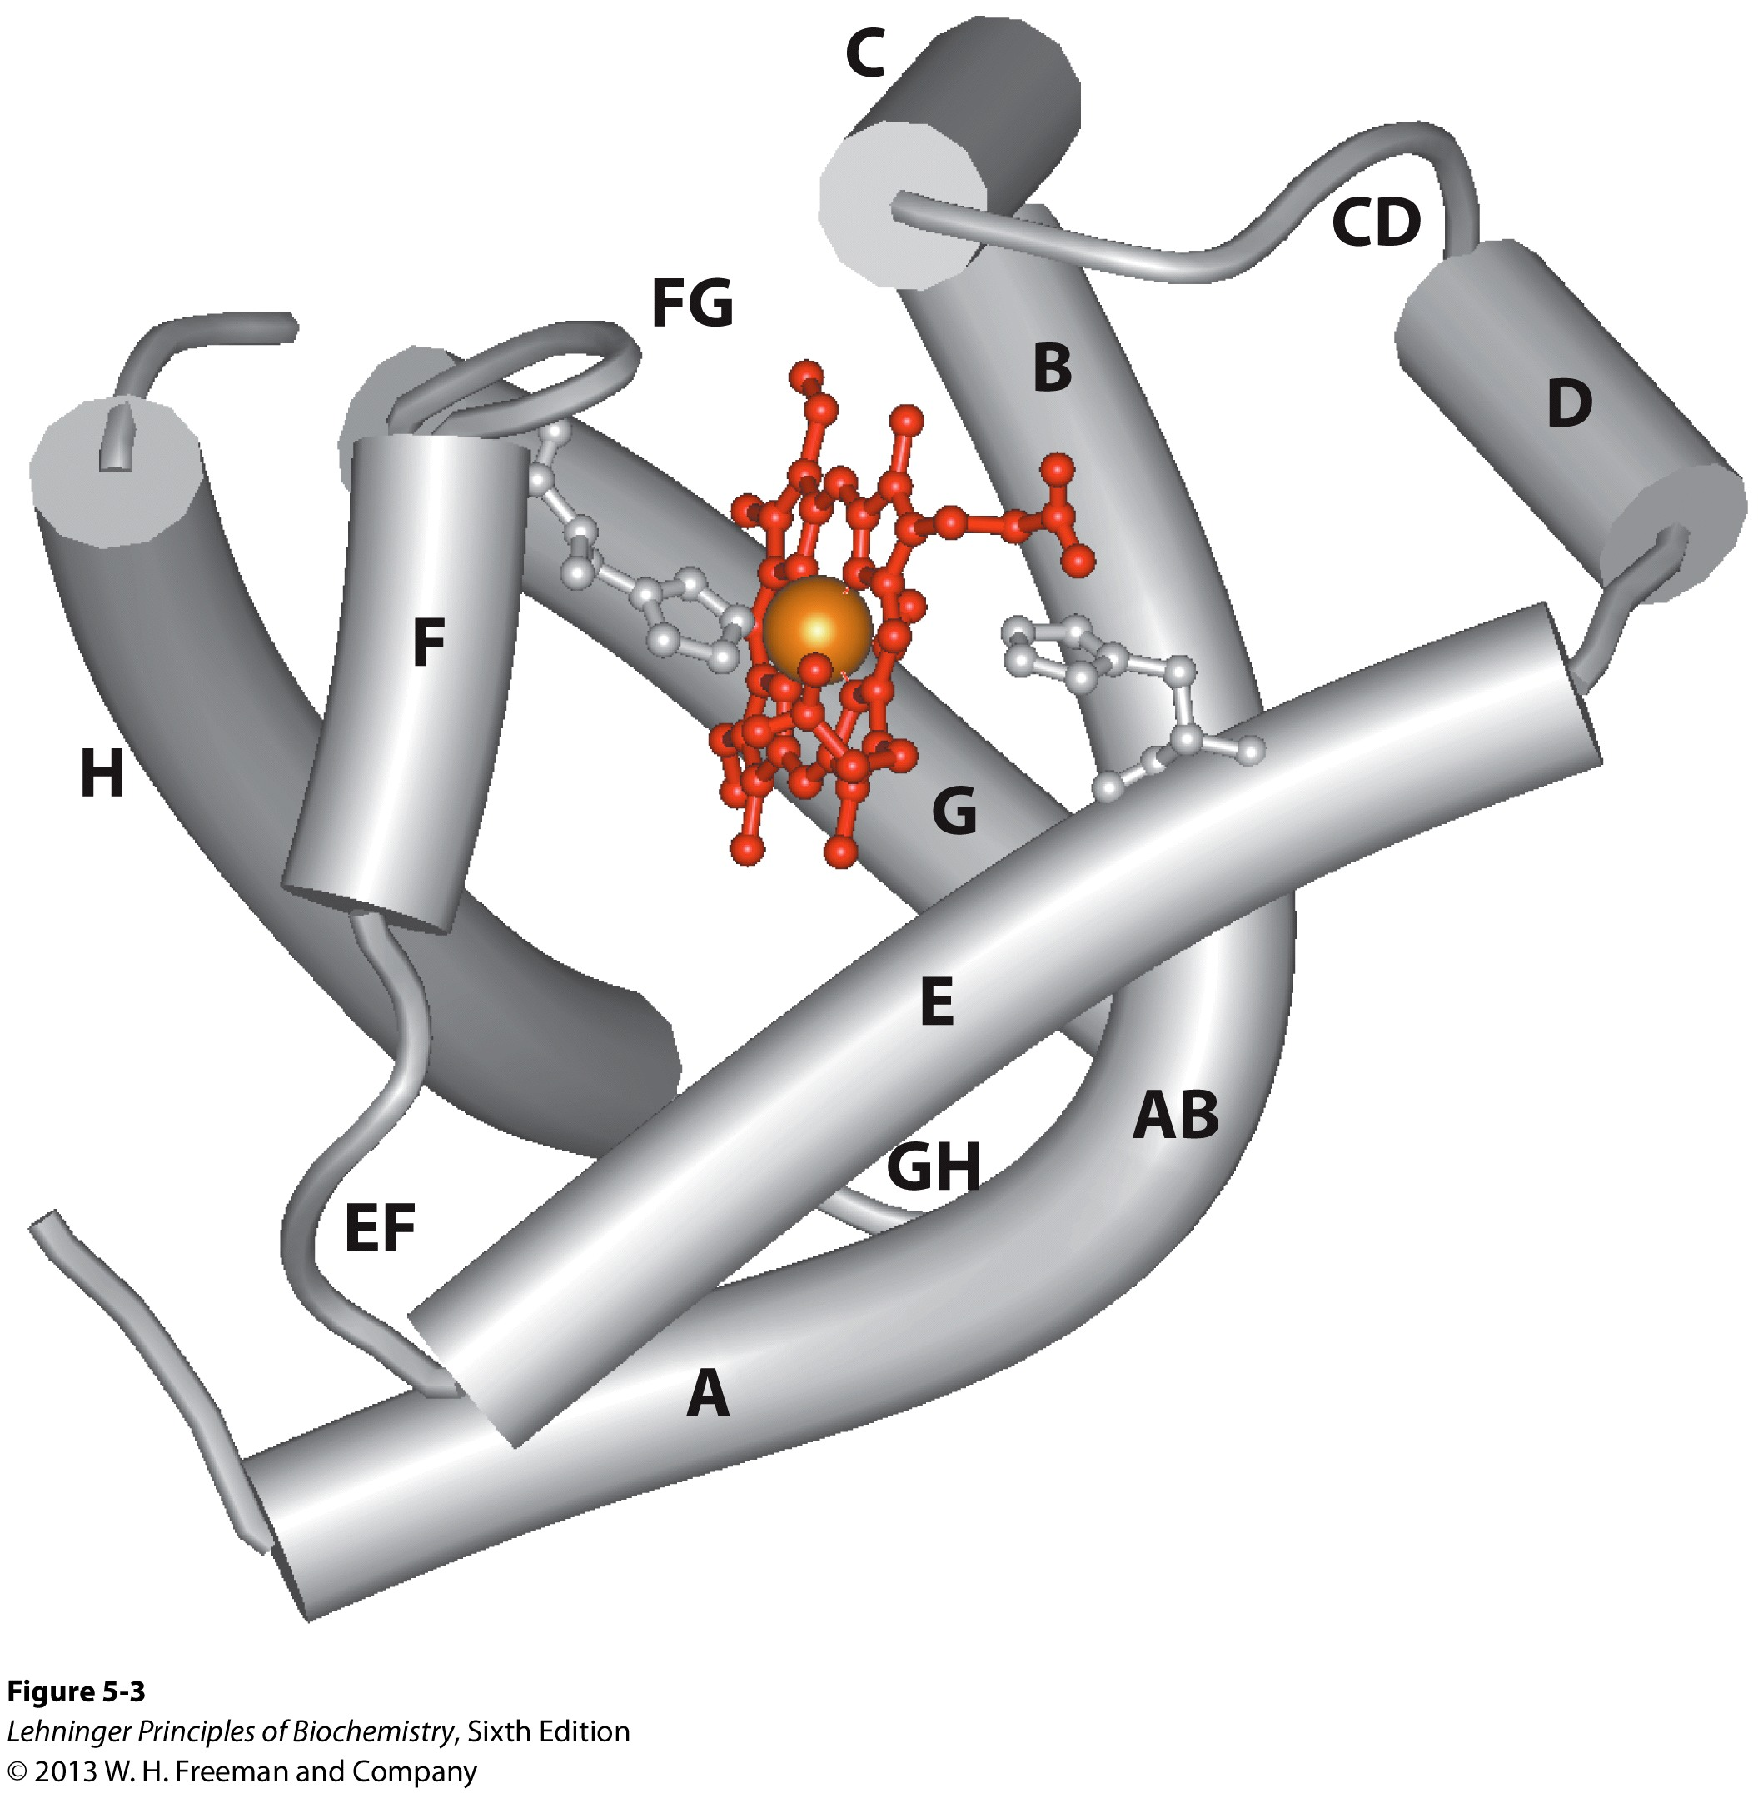
Ligand binding to a protein
A ligand is a molecule that binds to a biomolecule.
A ligand can be an ion, a small molecule, or another (smaller) protein.
A ligand binds at a site on the receptor molecule called the binding site.
Ligand binds via noncovalent interactions (hydrogen bond, hydrophobic interaction, ionic interaction, van der Waals interaction).
Ligand binding to a receptor molecule often induces a conformational change in the receptor molecule (induced fit and allosteric regulation).

Slide 9
Binding: Quantitative Description
Consider a process in which a ligand (L) binds reversibly to a site in a protein (P).
This interaction can be described quantitatively by the association rate constant k_{a} or the dissociation rate constant k_{d}.
After some time, the process will reach the equilibrium where the association and dissociation rates are equal.
The equilibrium composition is characterized
by the equilibrium association constant K_{a}
or the equilibrium dissociation constant, K_{d}.
k_{a}
+
k_{d}
P
L
PL

Slide 10
Analysis in Terms of the Bound Fraction
In practice, we can often determine the fraction of occupied binding sites (θ).
Substituting [PL] with K_{a}[L][P], we’ll eliminate [PL].
Eliminating [P] and rearranging gives the result in terms of equilibrium association constant.
In terms of the more commonly used equilibrium dissociation constant:

Slide 11
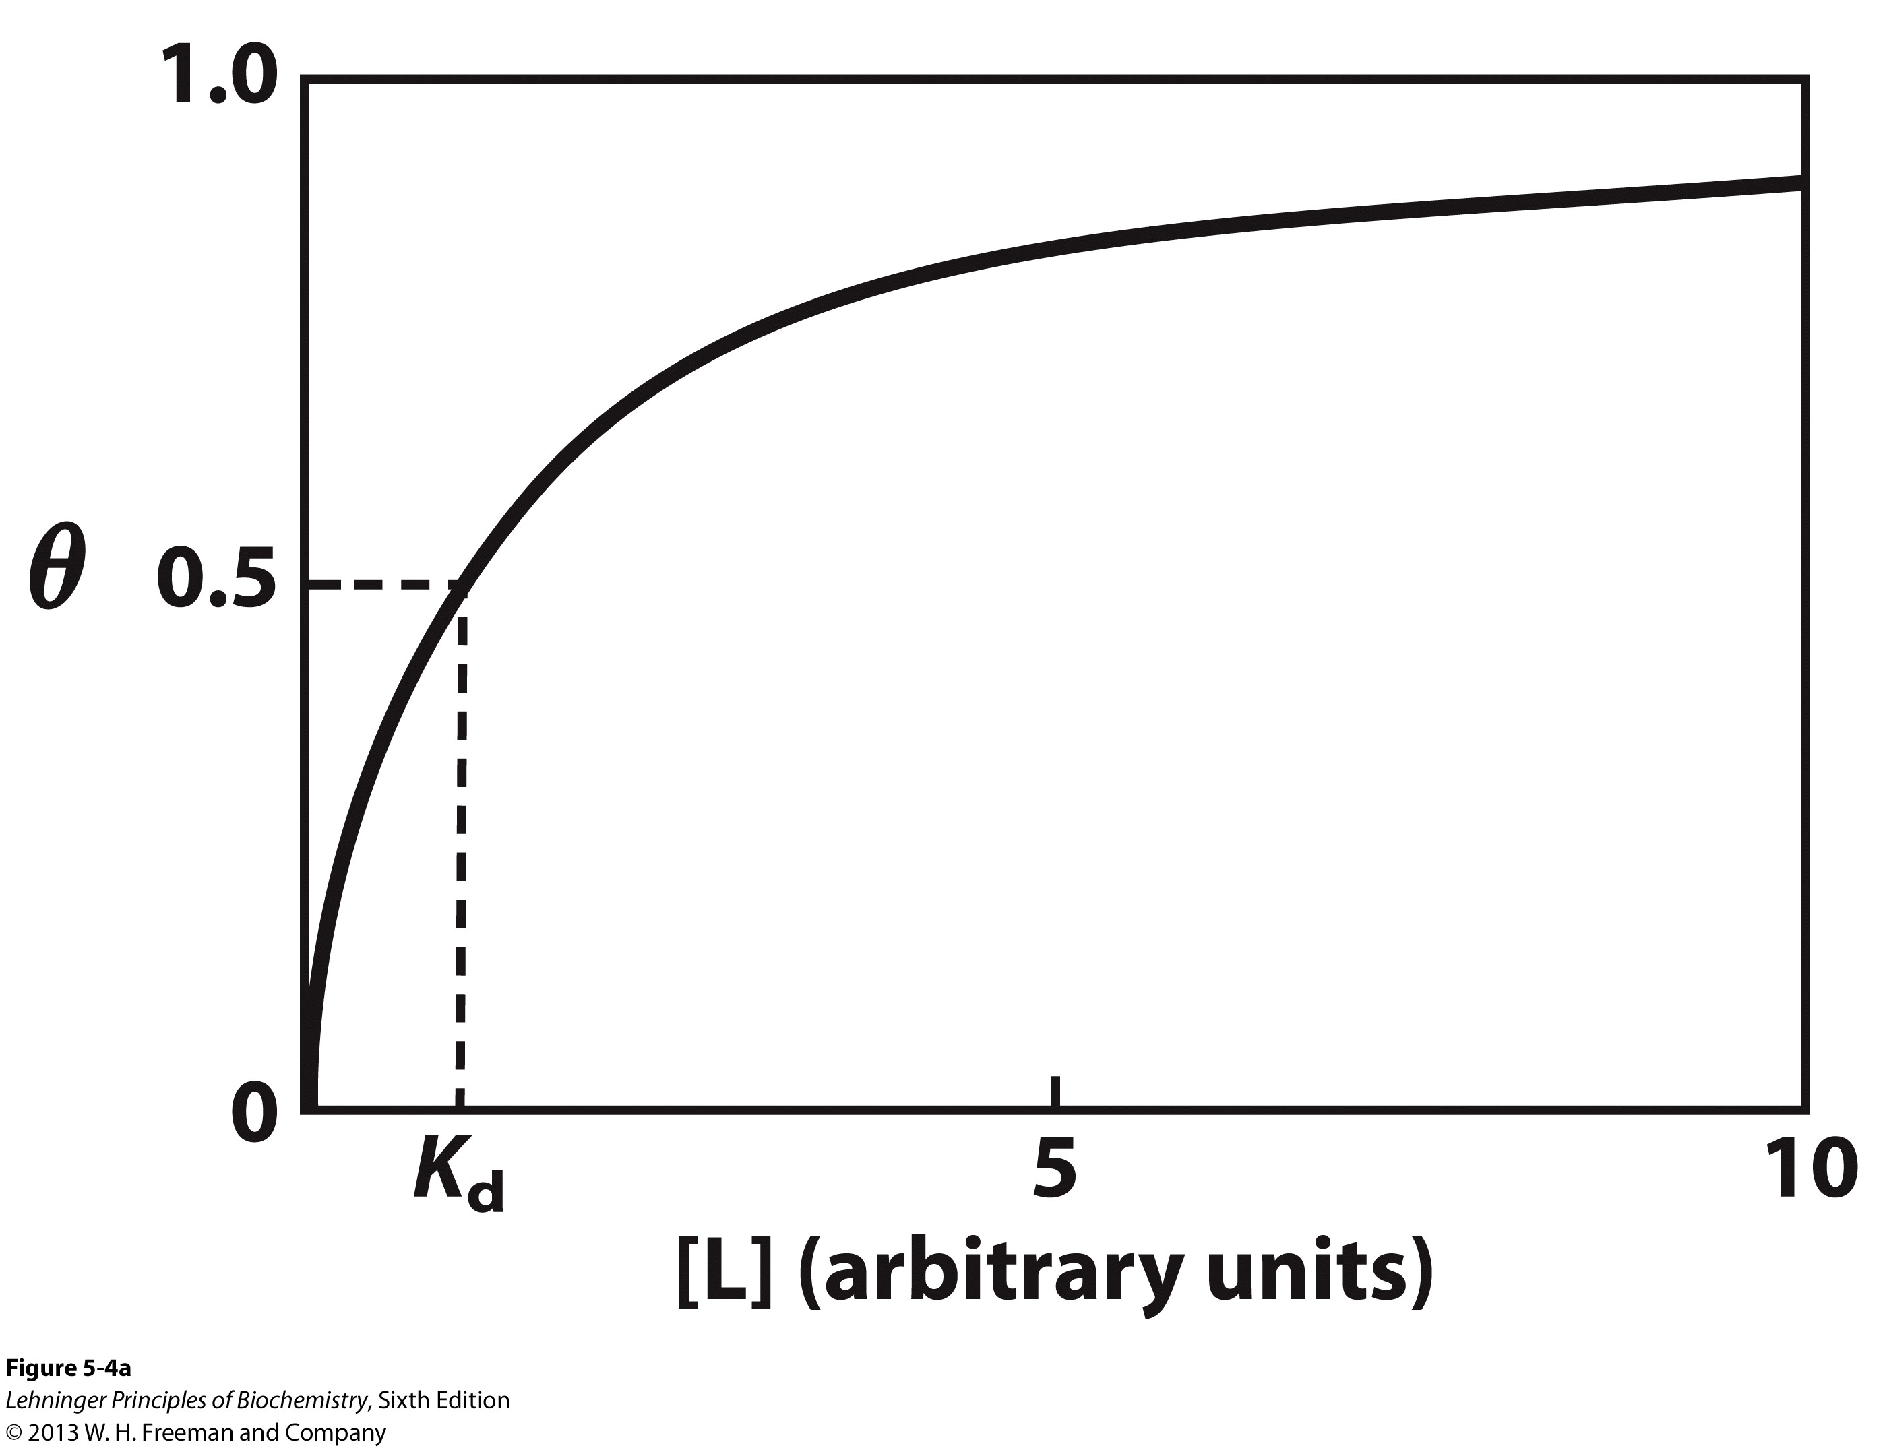
Binding: Graphical Analysis
K_{d} equals to the molar concentration of free ligand concentration at which half of available binding sites are occupied.
A lower value of the K_{d} corresponds to a higher affinity of the ligand for the protein.
Experimentally, ligand is usually in excess ( [L] ≈ [L]_{total} ). In order for 90% of the available ligand-binding sites to be occupied, [L] must be at least 9 times greater than the K_{d}.
Notes:
FIGURE 5-4a Graphical representations of ligand binding. The fraction of ligand-binding sites occupied, θ, is plotted against the concentration of free ligand. Both curves are rectangular hyperbolas. (a) A hypothetical binding curve for a ligand L. The [L] at which half of the available ligand-binding sites are occupied is equivalent to 1/K_{a}, or K_{d}. The curve has a horizontal asymptote at θ = 1 and a vertical asymptote (not shown) at [L] = –1/K_{a}.

Slide 12
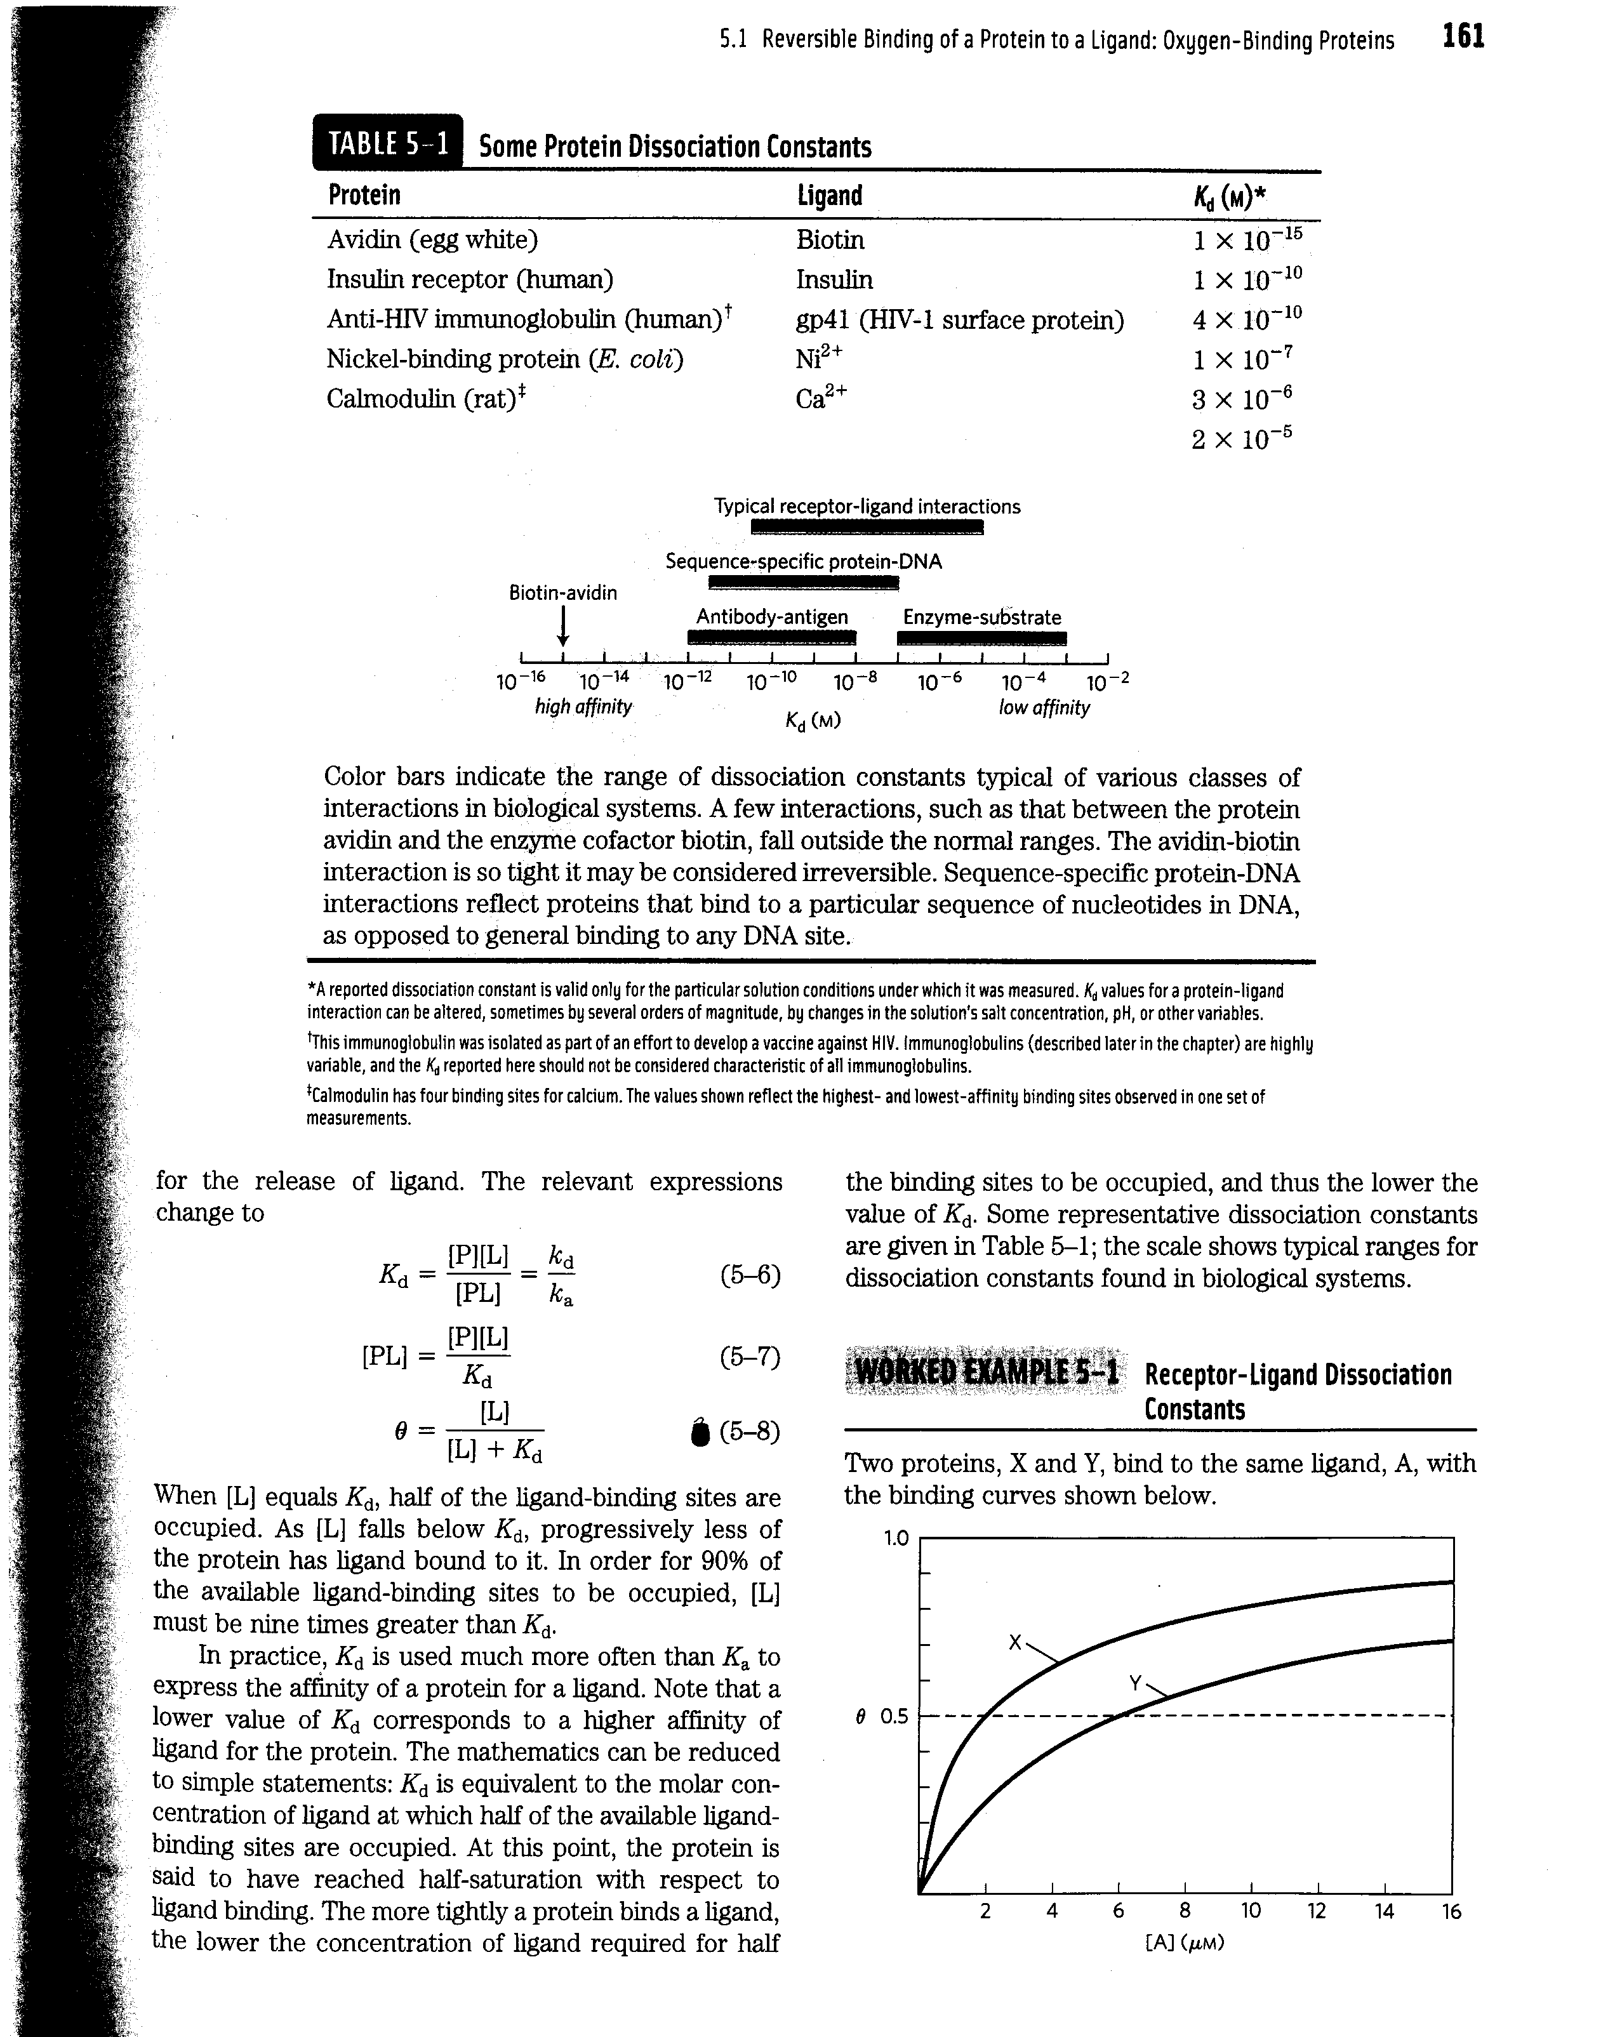
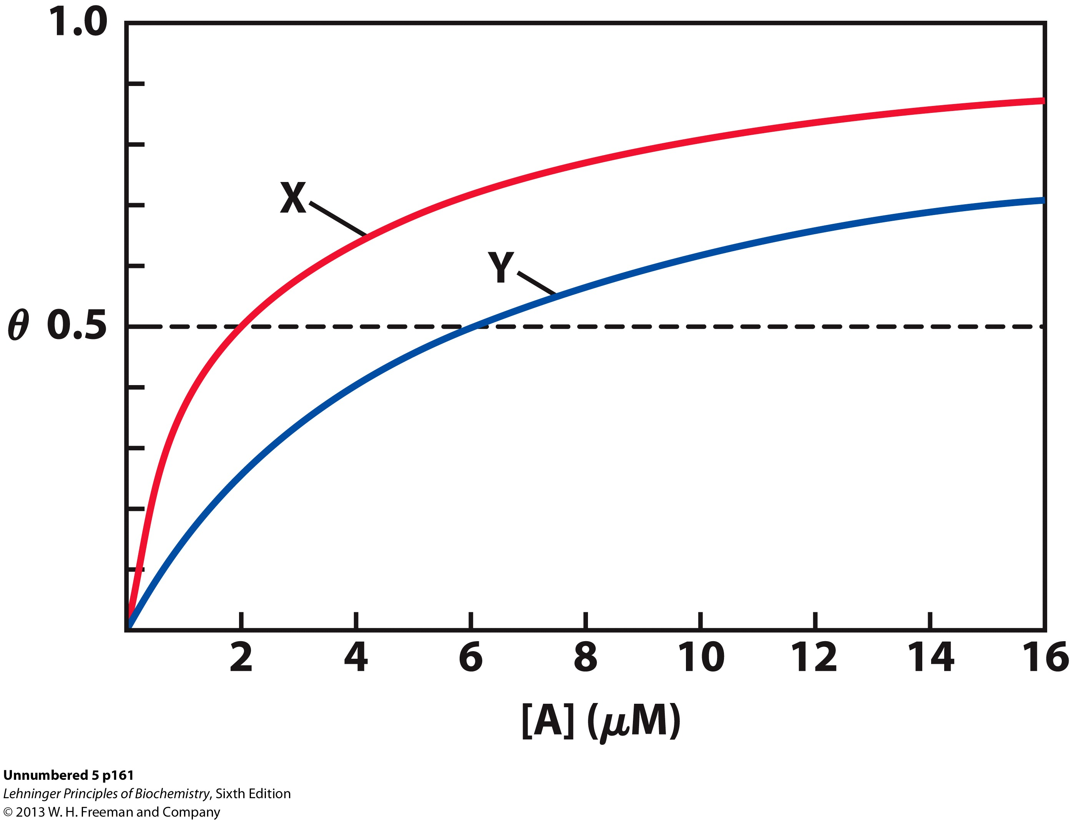
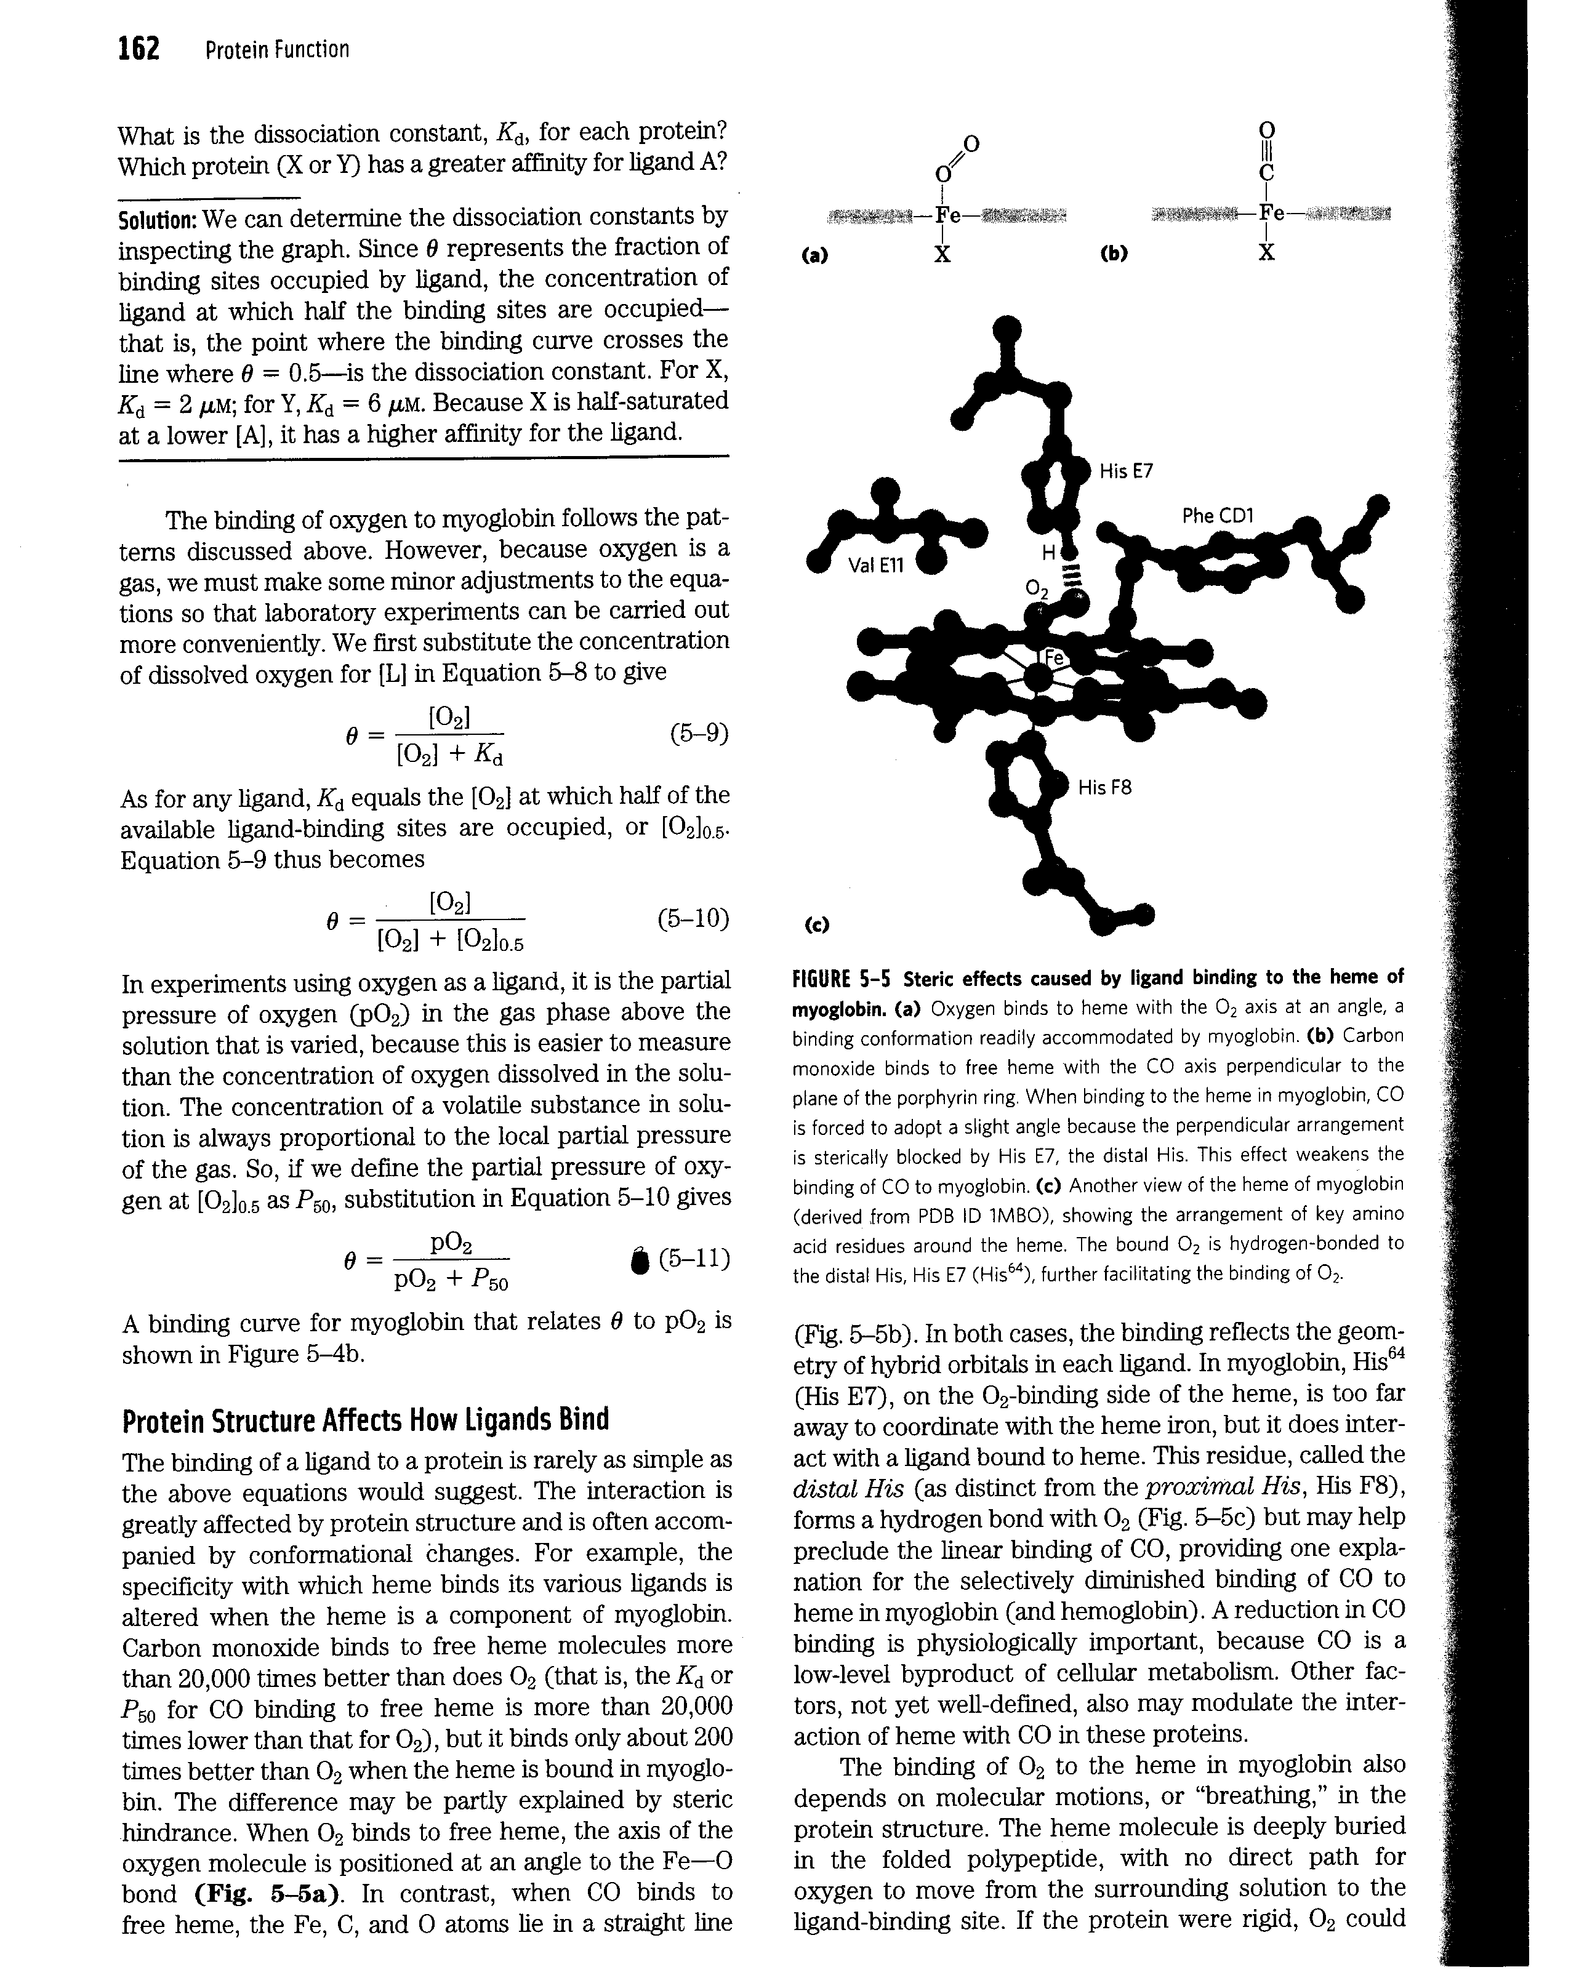

Slide 13
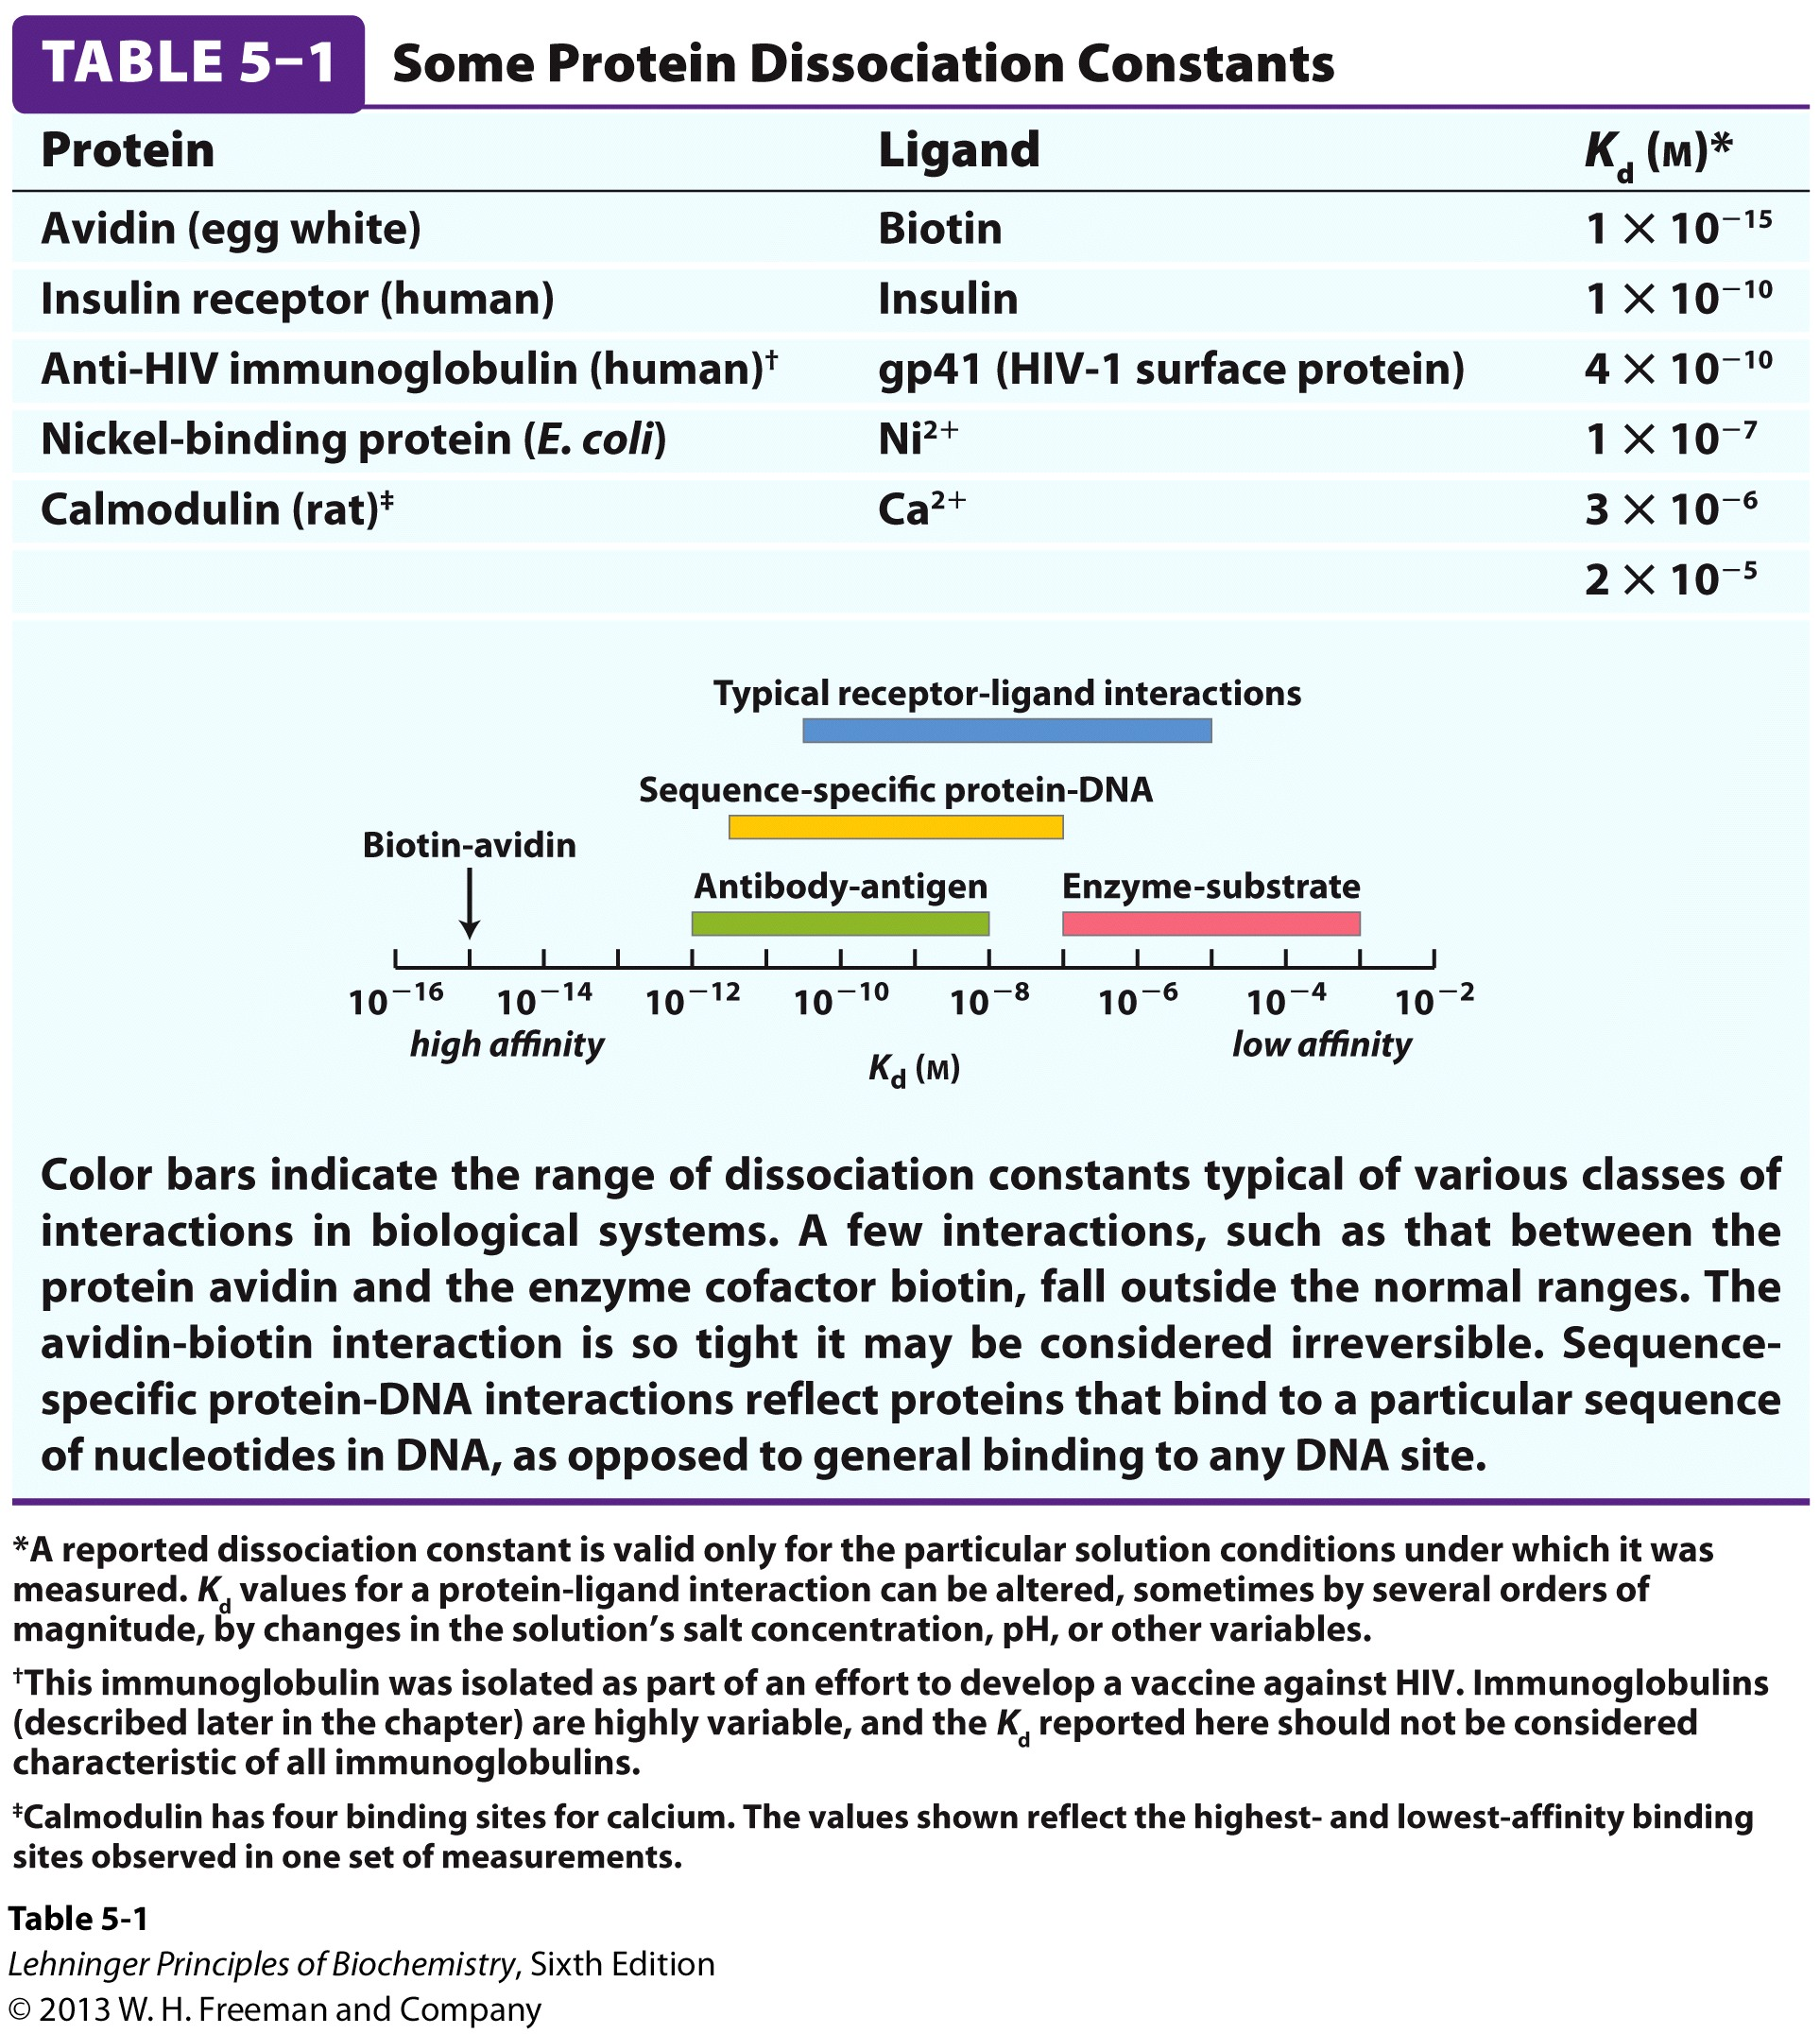

Slide 14
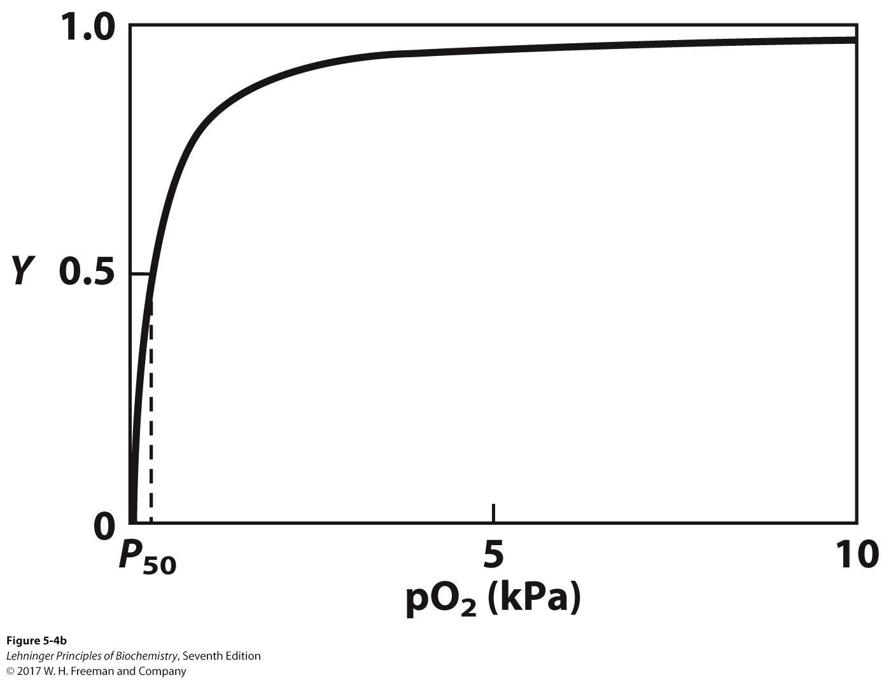
Oxygen Binding to Myoglobin
When a ligand is a gas, binding is expressed in terms of partial pressures.

Slide 15
Could Myoglobin Transport O₂?
pO₂ in lungs is about 13 kPa: it surely binds oxygen well.
pO₂ in tissues is about 4 kPa: it will not release it!

Slide 16
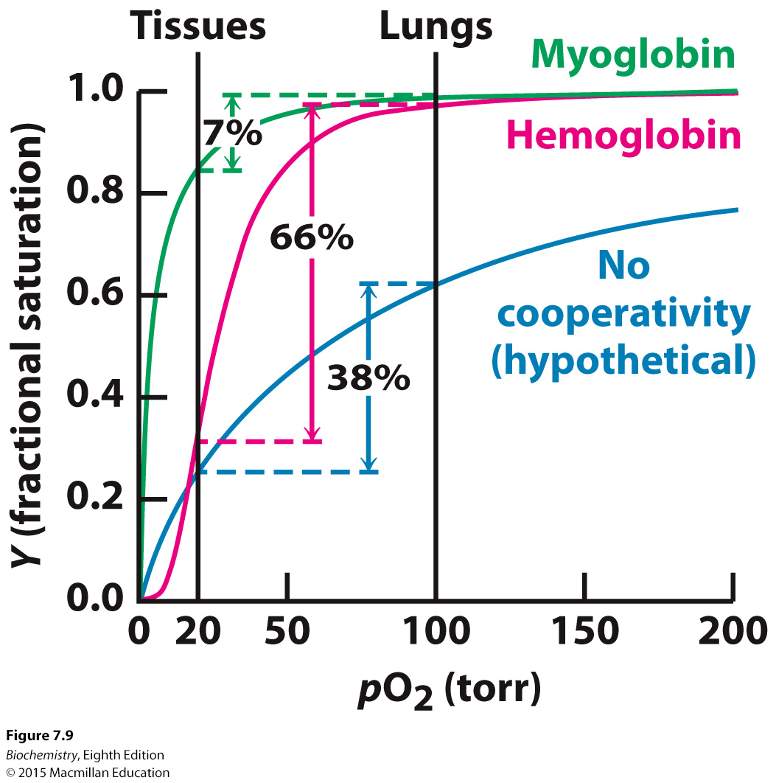
The cooperativity allows hemoglobin to bind oxygen in the lungs and release oxygen at the tissues
Notes:
Hb must bind O₂ efficiently in the lungs, where [O₂] is high; and release O₂ in the tissues, where [O₂] is low.
A protein (such as myoglobin) that binds O₂ with high affinity would bind it efficiently in the lungs, but would not release much of it in the tissues.
A protein bound O₂ with low affinity would not pick up much O₂ in the lungs.
Hb solves the problem by undergoing a structural transition from a low-affinity T state to a high-affinity R state as more O₂ molecules are bound.
As a result, Hb has a hybrid S-shaped, or sigmoid, binding curve for O₂. A sigmoid curve can be viewed as a hybrid curve reflecting the transition between low- and high-affinity structural states in Hb on O₂ binding.
Sigmoidal ligand binding curves are indicative of cooperative binding of a ligand to a protein. In cooperative binding, the binding of one ligand to a protein alters its binding affinity for subsequent ligands.

Slide 17
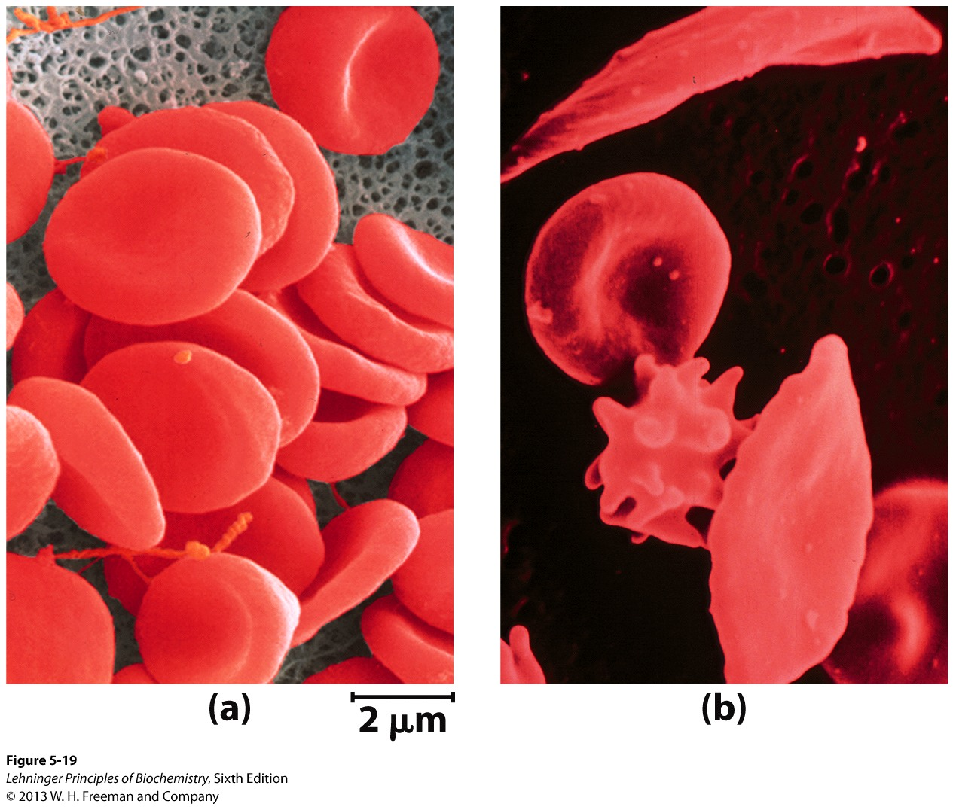
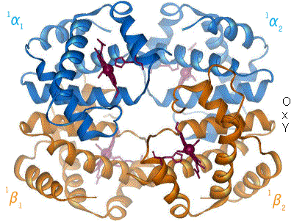
Hemoglobin transports oxygen in blood
Notes:
96% of red blood cell’s dry content, and 35% of the total content

Slide 18
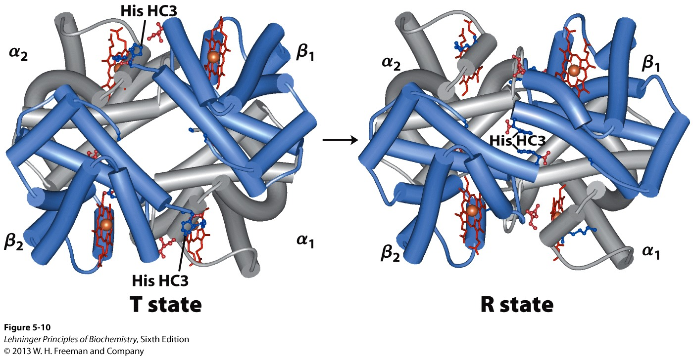
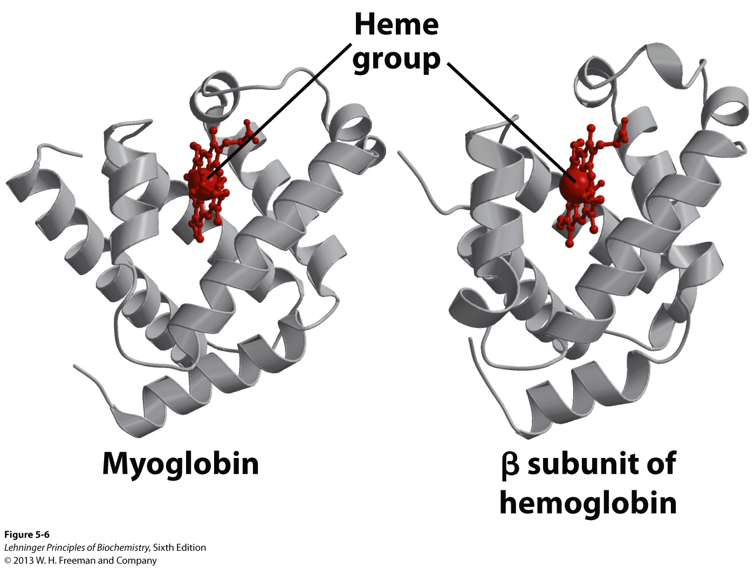
Hemoglobin subunits are structurally similar to myoglobin
Hemoglobin (Hb) is a tetramer of two subunits (α2β2).
Each subunit is similar to myoglobin.

Slide 19
Hemoglobin undergoes a structural change on O₂ binding
(Low affinity)
(High affinity)
The terms “tense” and “relaxed” were originally coined because the T state is stabilized by a greater number of ion pairs at the α1-β2 and α2-β1 interfaces than are present in the R state.

Slide 20
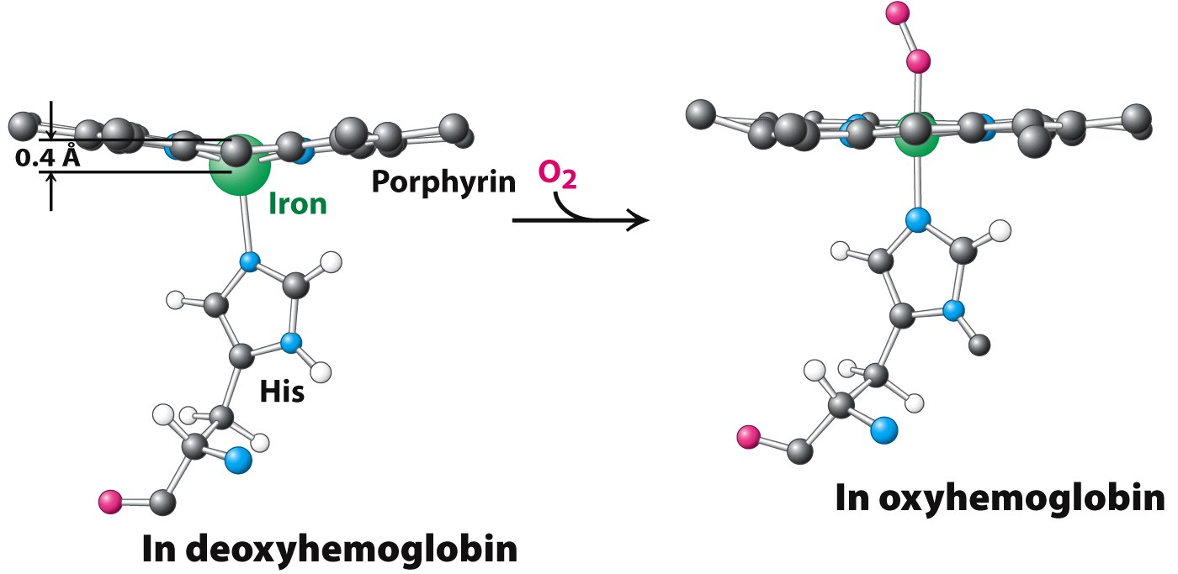
Binding of O₂ causes the heme to assume a more planar conformation

Slide 21
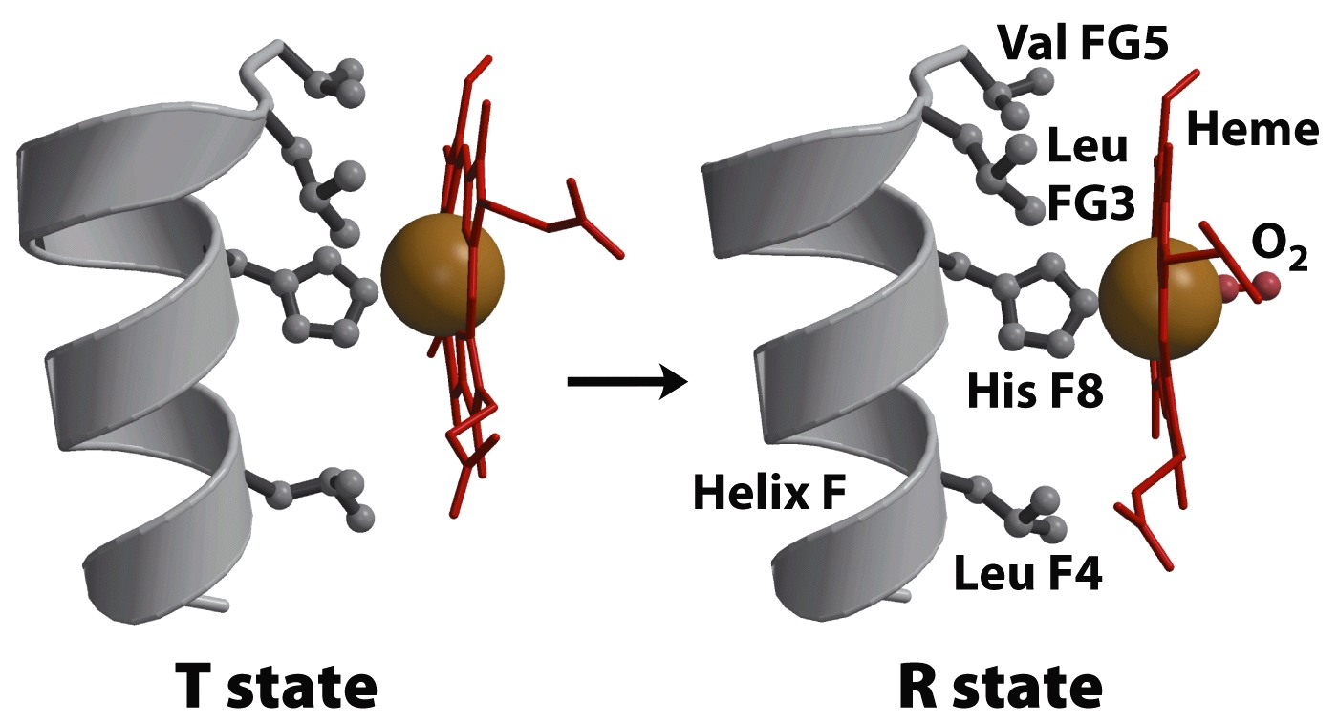
The shift in the position of helix F when heme binds O₂ triggers the T → R transition
Notes:
Binding of O₂ causes the heme to assume a more planar conformation, shifting the position of the proximal His and the attached F helix.
The resulting structural change is communicated through the subunit, resulting in the breaking of ion pair interactions between the α1-β2 interface and the formation of the R state.

Slide 22
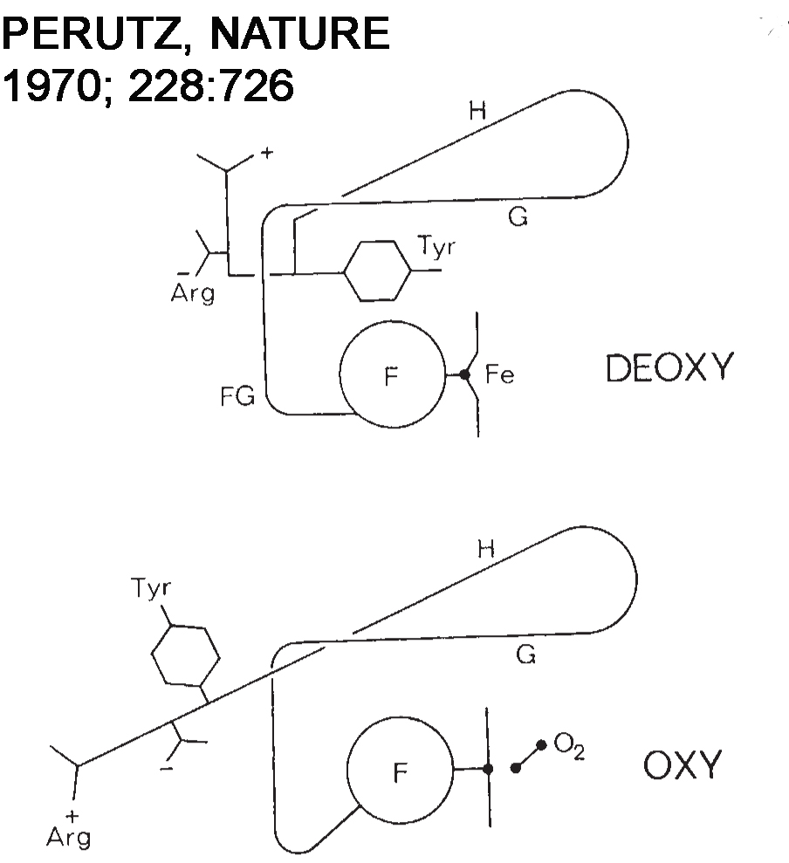
A small movement triggers a large conformational change

Slide 23
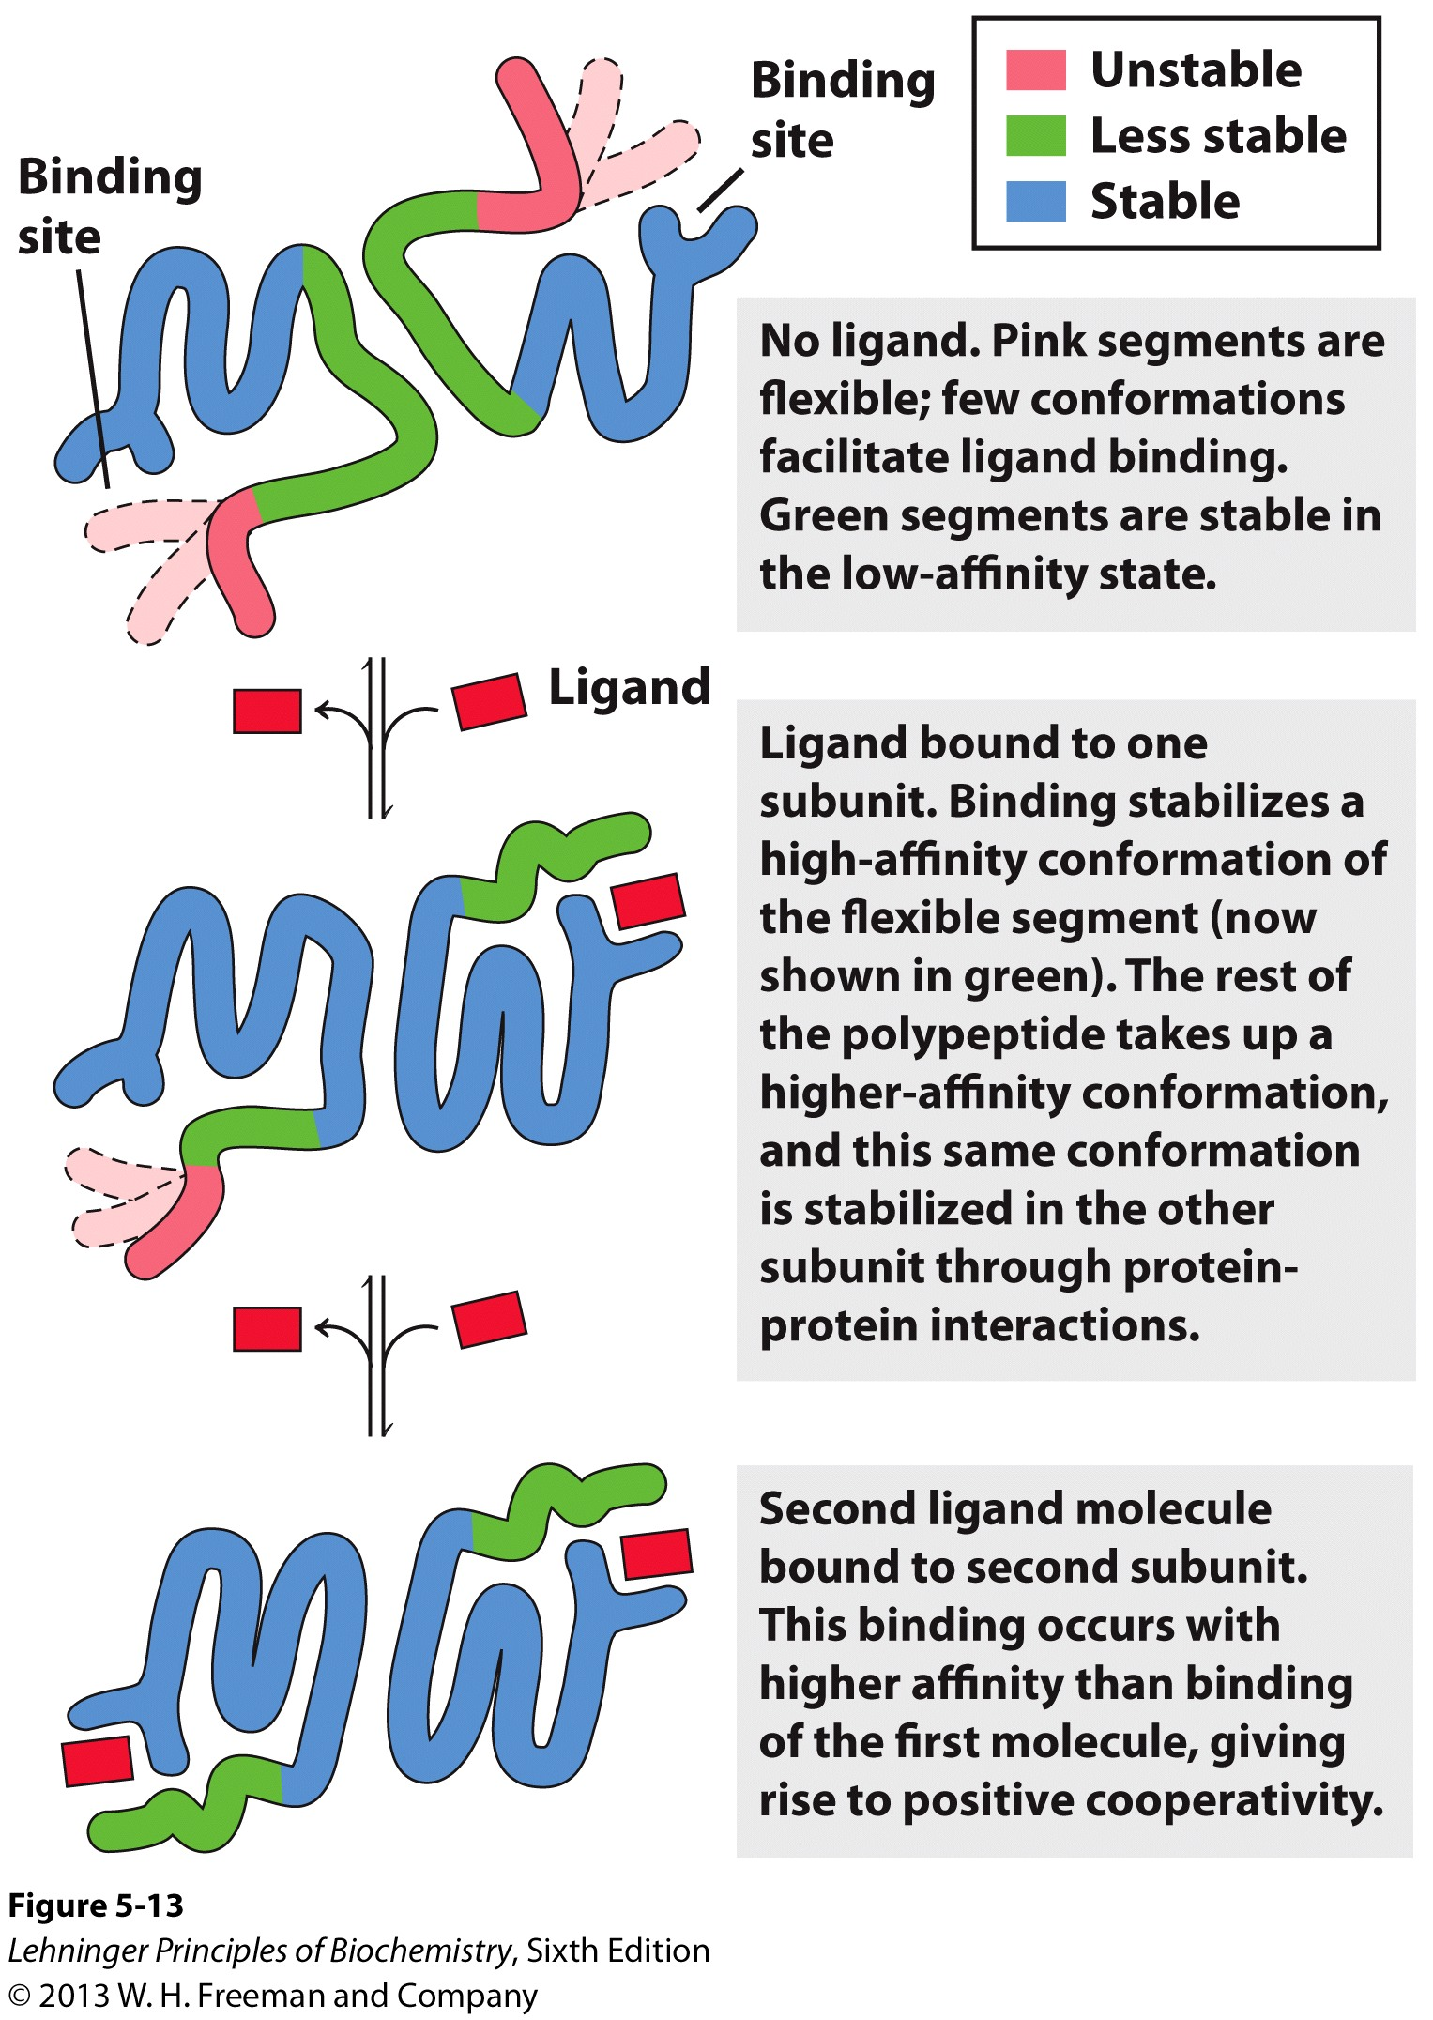
Cooperativity

Slide 24
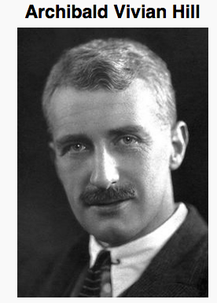
Cooperative ligand binding can be described quantitatively
The macromolecule is assumed to bind to n ligands simultaneously, with no intermediate steps in the binding (an all or none model, which is physically implausible but simplifies things)
Hill equation
n_{H} = 1, the binding is not cooperative;
When n_{H} >1, the binding is positively cooperative;
When n_{H} <1, the binding is negatively cooperative.
Hill AV. (1910). "The possible effects of the aggregation of the molecules of hæmoglobin on its dissociation curves". J. Physiol. 40 (Suppl): iv–vii.
Notes:
θ - fraction of occupiedK_{d}- Apparent dissociation constant
sites; L - free ligand concentration;

Slide 25
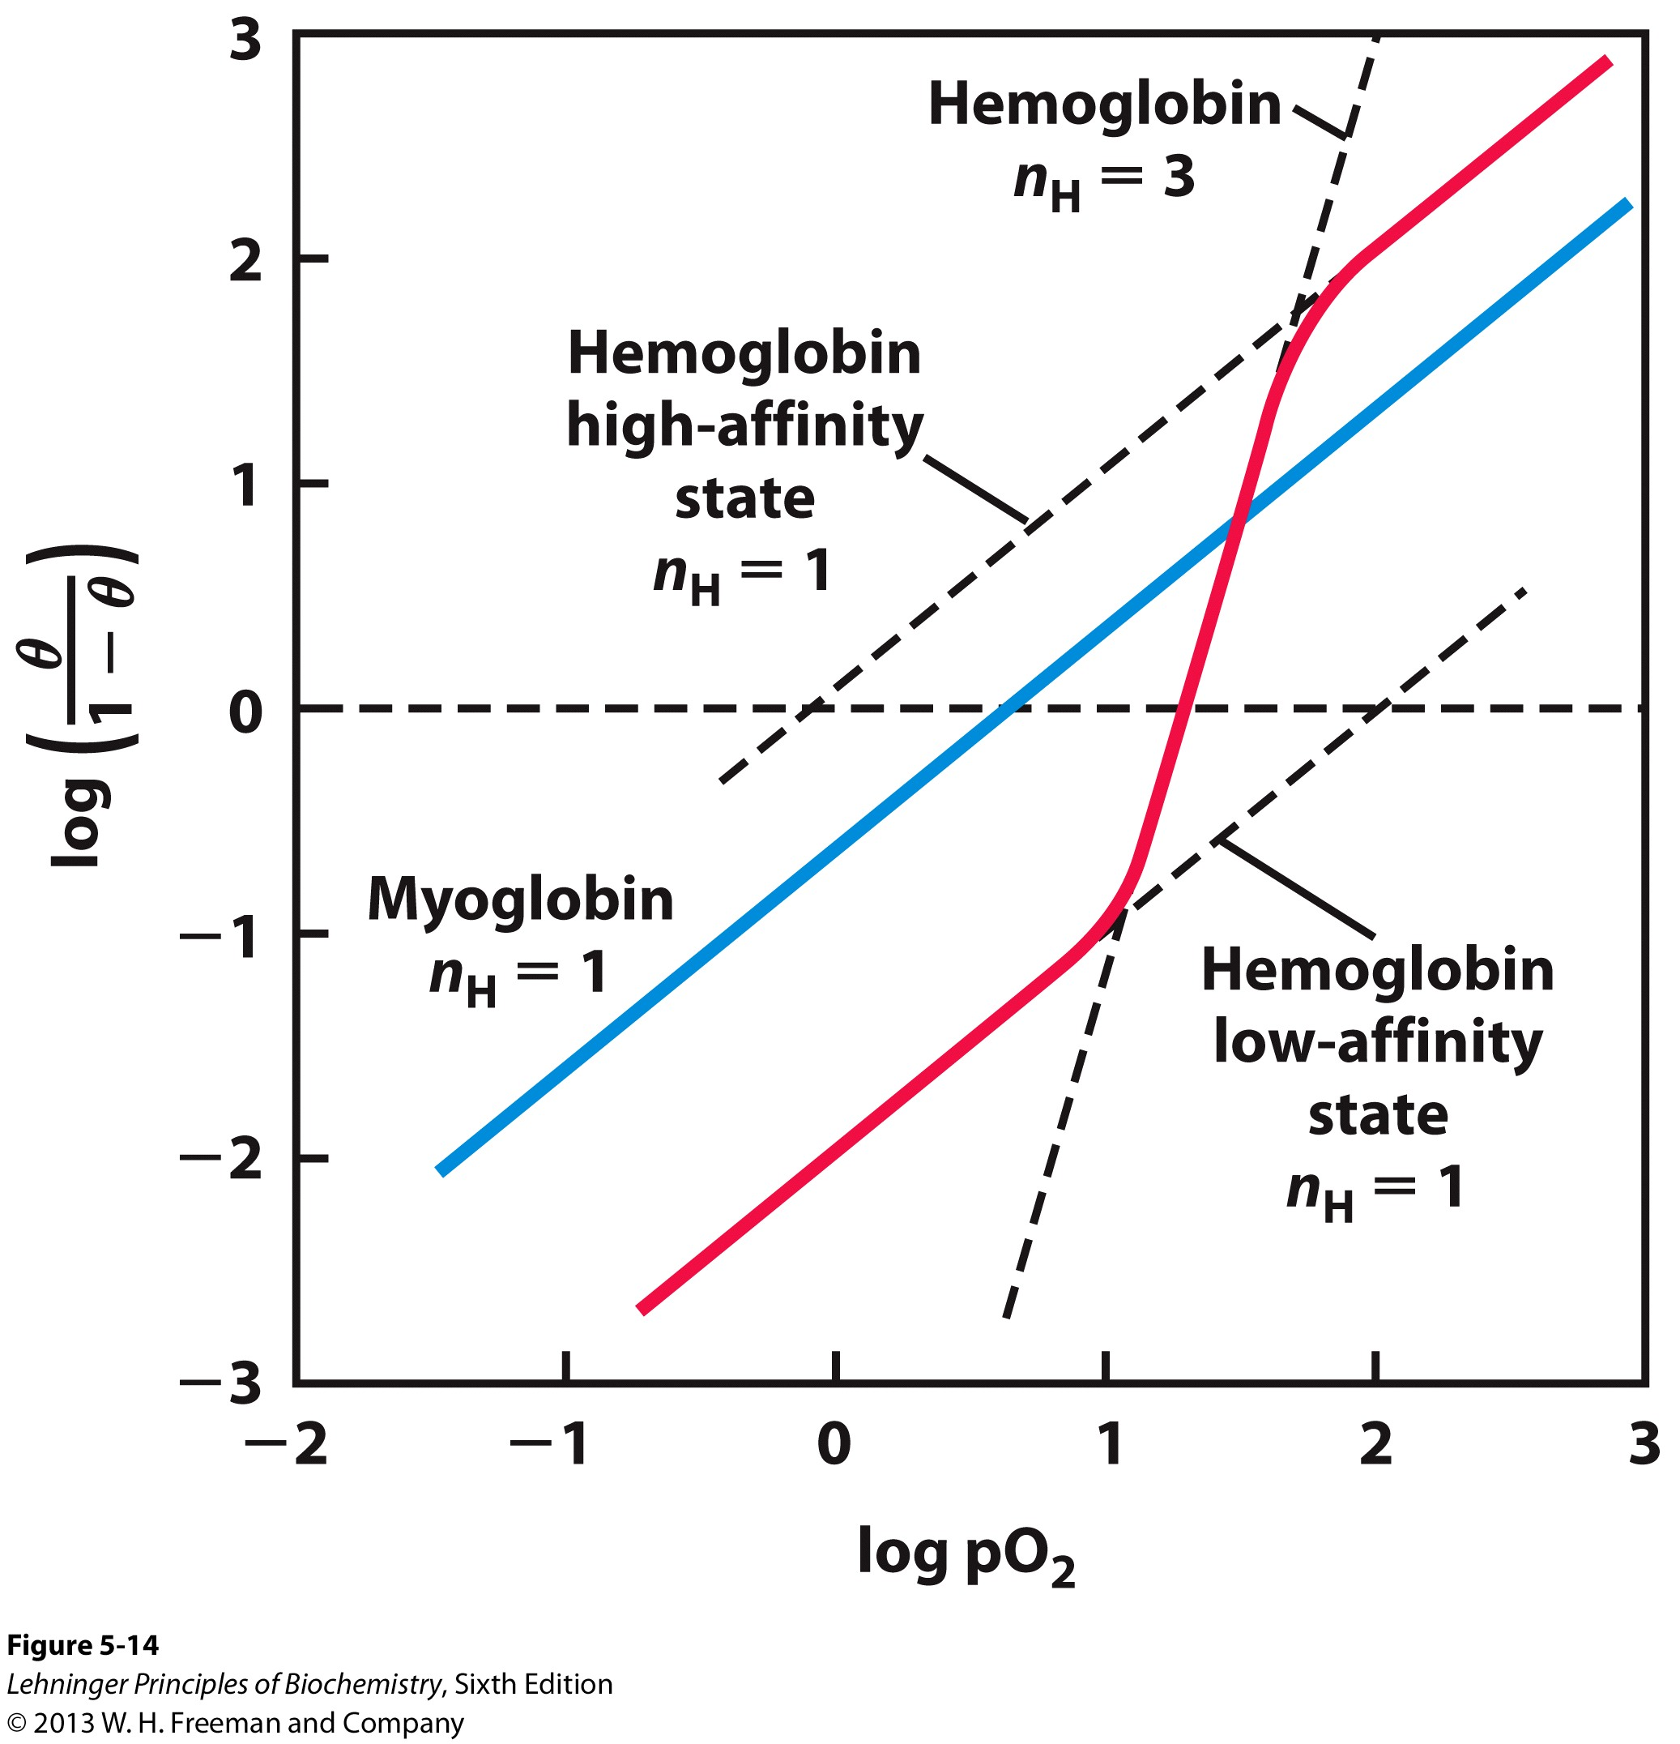
Hill plots for O₂ binding to myoglobin and hemoglobin

Slide 26
Cooperativity is a case of allosteric regulation
Allosteric protein
Binding of a ligand to one site affects the binding properties of a different site on the same protein.
The term allostery comes from the Greek allos (ἄλλος), "other," and stereos(στερεὀς), "solid or shape”--the regulatory site of an allosteric protein is physically distinct from its active site.
can be positive or negative
homotropic
The normal ligand of the protein is the allosteric regulator.
heterotropic
A different ligand affects binding of the normal ligand.
Cooperativity = positive homotropic regulation

Slide 27
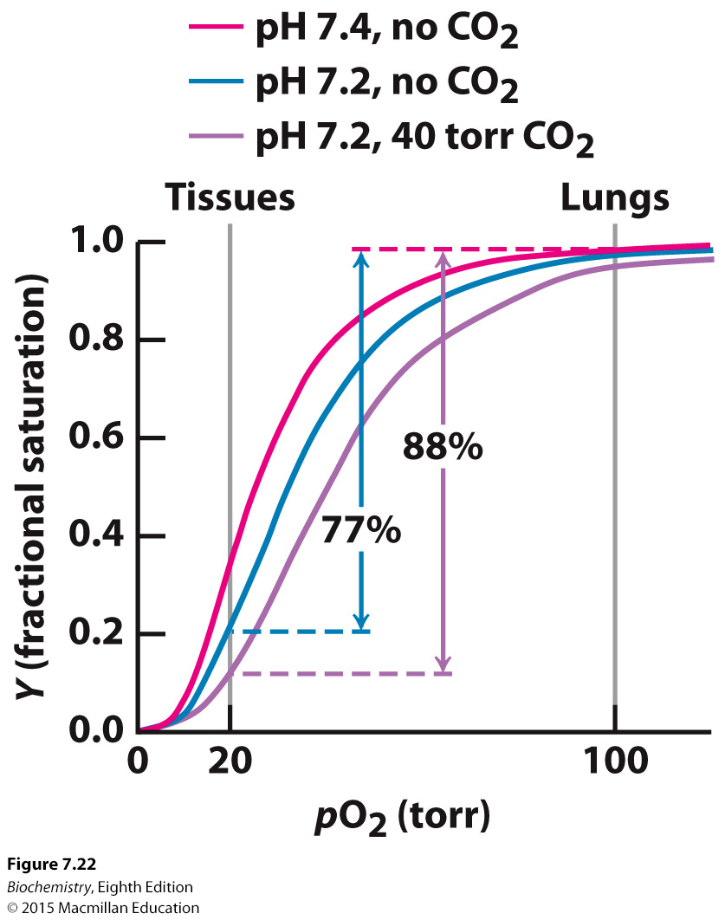
The Bohr effect: O₂ binding to Hb is regulated by H⁺ and CO₂
The Bohr effect is a physiological phenomenon first described in 1904 by the Danish physiologist Christian Bohr, stating that hemoglobin's oxygen binding affinity is inversely related both to acidity and to the concentration of carbon dioxide.

Slide 28
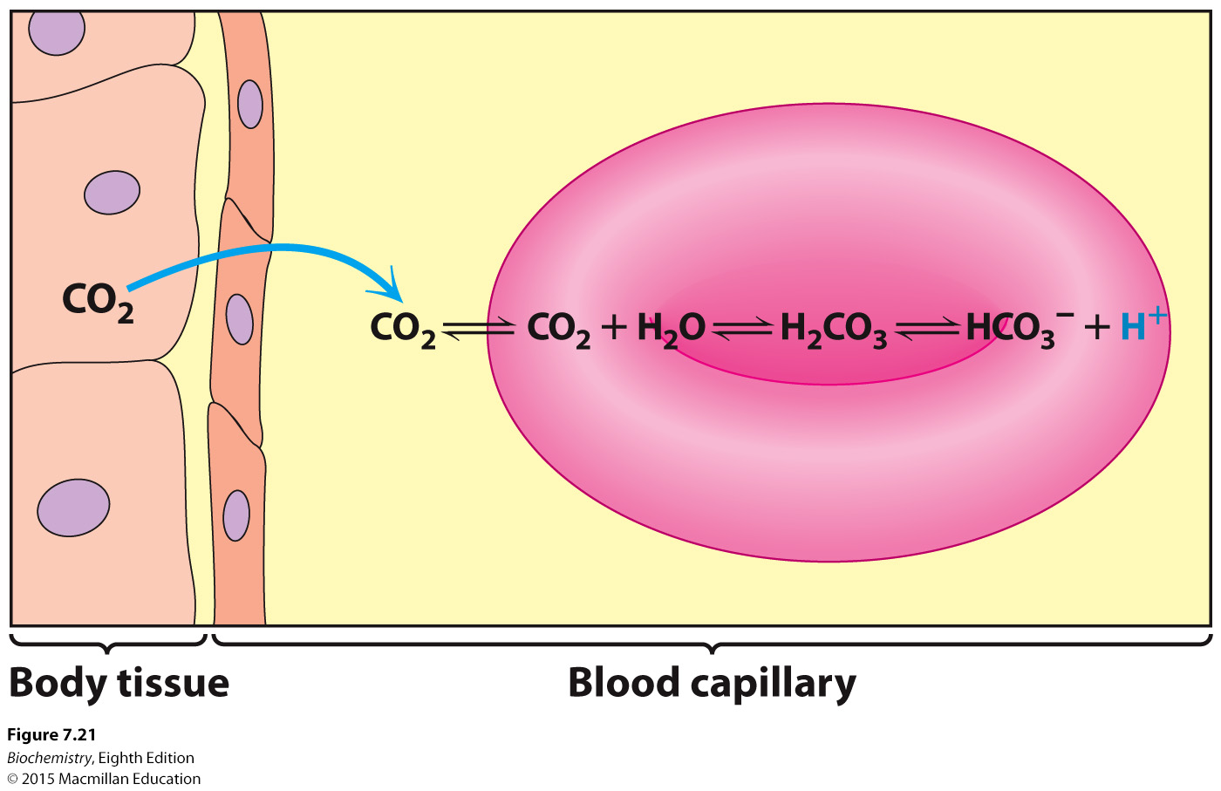
Notes:
FIGURE 7.21 Carbon dioxide and pH. Carbon dioxide in the tissues diffuses into red blood cells. Inside a red blood cell, carbon dioxide reacts with water to form carbonic acid, in a reaction catalyzed by the enzyme carbonic anhydrase. Carbonic acid dissociates to form HCO⁻₃ and H⁺, resulting in a drop in pH inside the red cell.

Slide 29
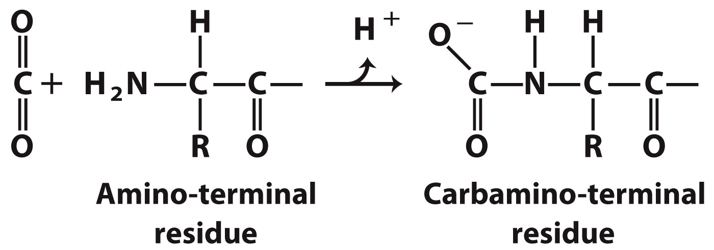
H⁺ and CO₂ Export
40% of the total H⁺ formed in the tissue is transported by Hb, binding to several residues in Hb (especially His)
15–20% of CO₂ is exported in the form of a carbamate on the amino terminal residues of each of the polypeptide subunits.
Binding of H⁺ and formation of the carbamate lead to the formation of additional salt bridges, stabilizing the T state.
H+ and CO2 are thus allosteric effectors of hemoglobin.

Slide 30
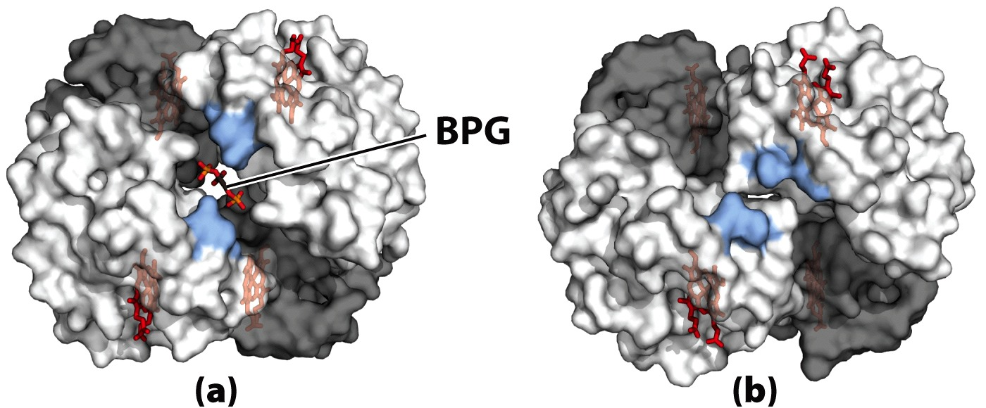
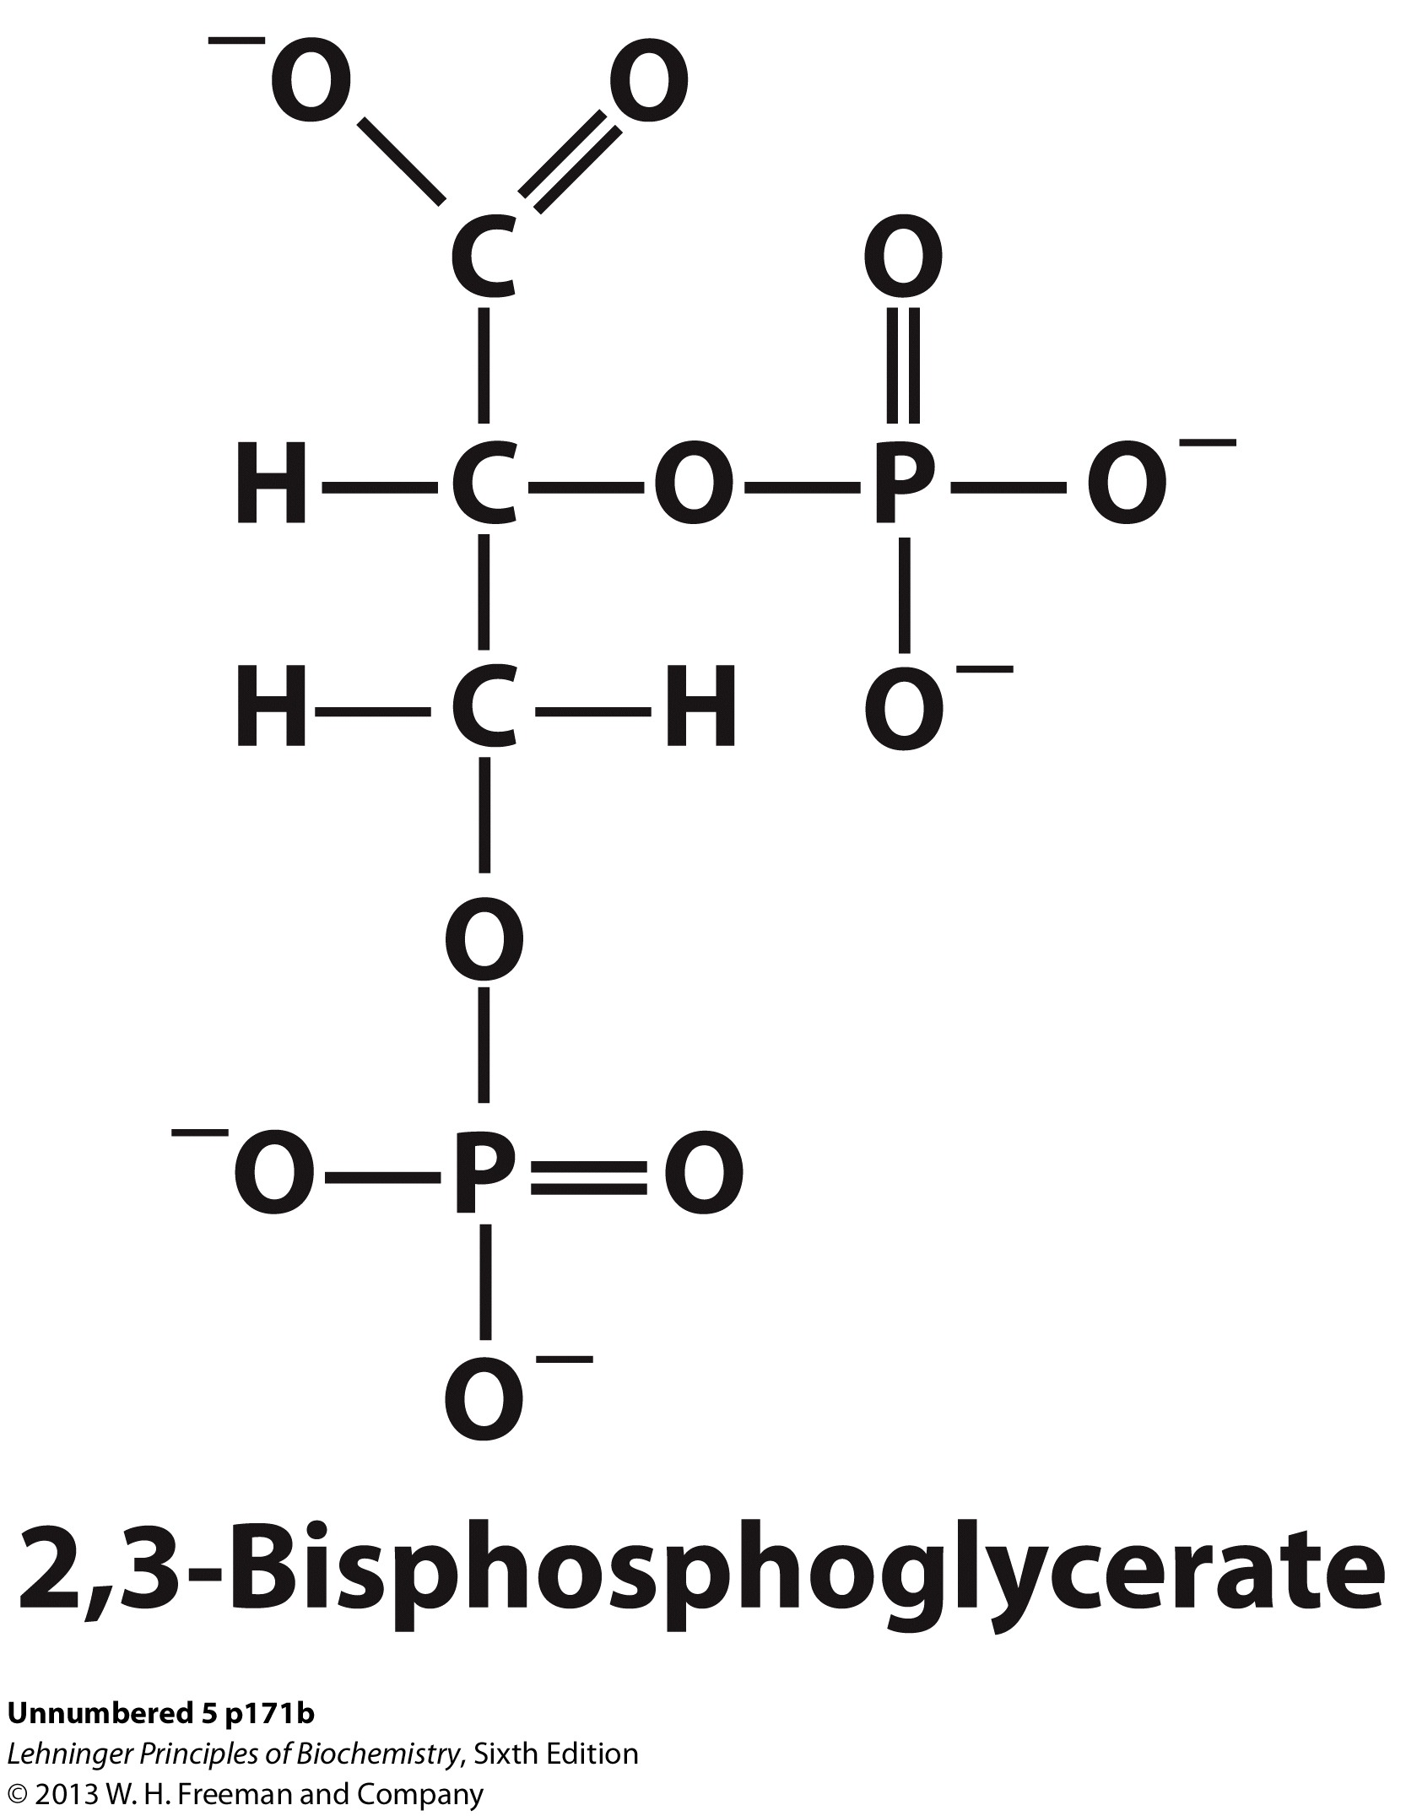
O2 binding to Hb is regulated by 2,3-BPG
T state
R state
2,3-BPG binds to the central cavity of Hb and stabilizes the T state.
2,3-BPG is a byproduct of glycolysis in actively metabolizing tissue: Again, demanding the Hb to release more O₂.

Slide 31
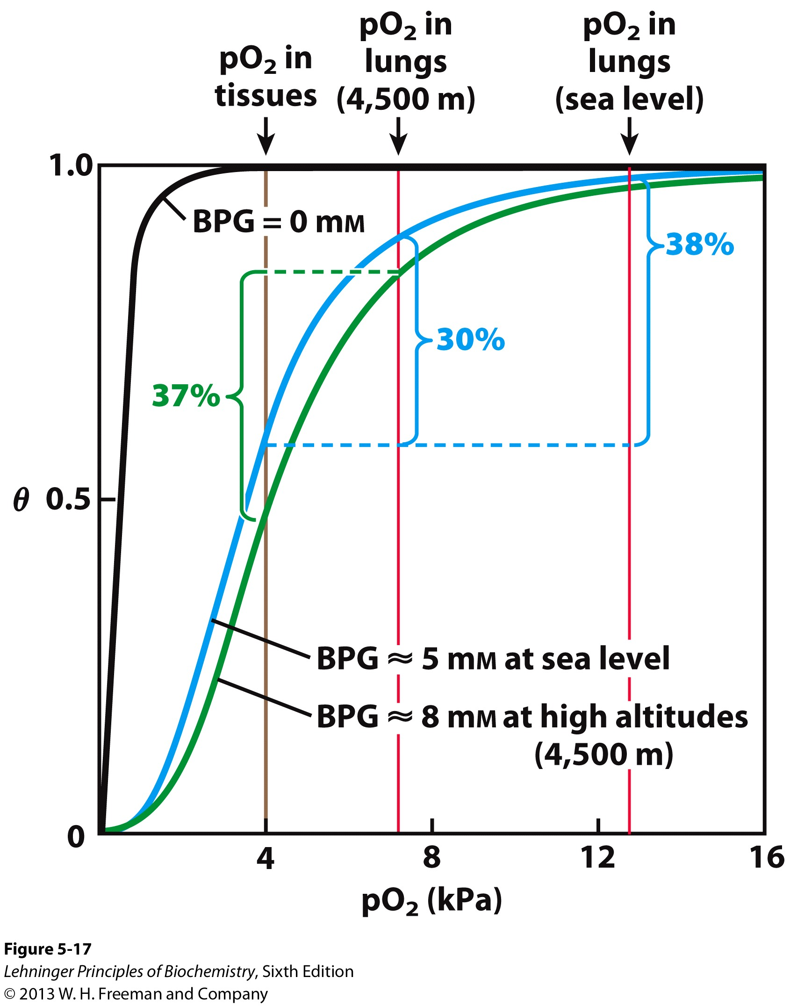
2,3-BPG facilitates adaptation to changes in altitude
More 2,3-BPG is produced when one moves to high altitudes or subject to hypoxia (lowered tissue O₂ level), to maintain the level of O₂ delivered to the tissues.
Notes:
FIGURE 5–17 Effect of BPG on oxygen binding to hemoglobin. The BPG concentration in normal human blood is about 5 mM at sea level and about 8 mM at high altitudes. Note that hemoglobin binds to oxygen quite tightly when BPG is entirely absent, and the binding curve seems to be hyperbolic. In reality, the measured Hill coefficient for O₂-binding cooperativity decreases only slightly (from 3 to about 2.5) when BPG is removed from hemoglobin, but the rising part of the sigmoid curve is confined to a very small region close to the origin. At sea level, hemoglobin is nearly saturated with O₂ in the lungs, but just over 60% saturated in the tissues, so the amount of O₂ released in the tissues is about 38% of the maximum that can be carried in the blood. At high altitudes, O₂ delivery declines by about one-fourth, to 30% of maximum. An increase in BPG concentration, however, decreases the affinity of hemoglobin for O₂, so approximately 37% of what can be carried is again delivered to the tissues.

Slide 32
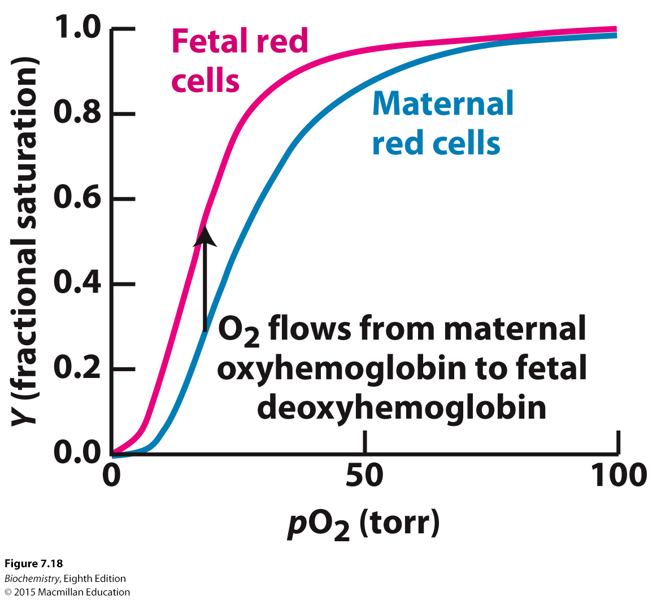
In fetal hemoglobin, the β chain is replaced with a γ chain
Fetal hemoglobin must bind oxygen at the pO₂ that mother’s hemoglobin is releasing oxygen.
The fetal α₂γ₂ hemoglobin does not bind 2,3-BPG as well as adult hemoglobin does. The reduced affinity for 2,3-BPG results in fetal hemoglobin having a higher affinity for oxygen, binding oxygen when the mother’s hemoglobin is releasing oxygen.

Slide 33
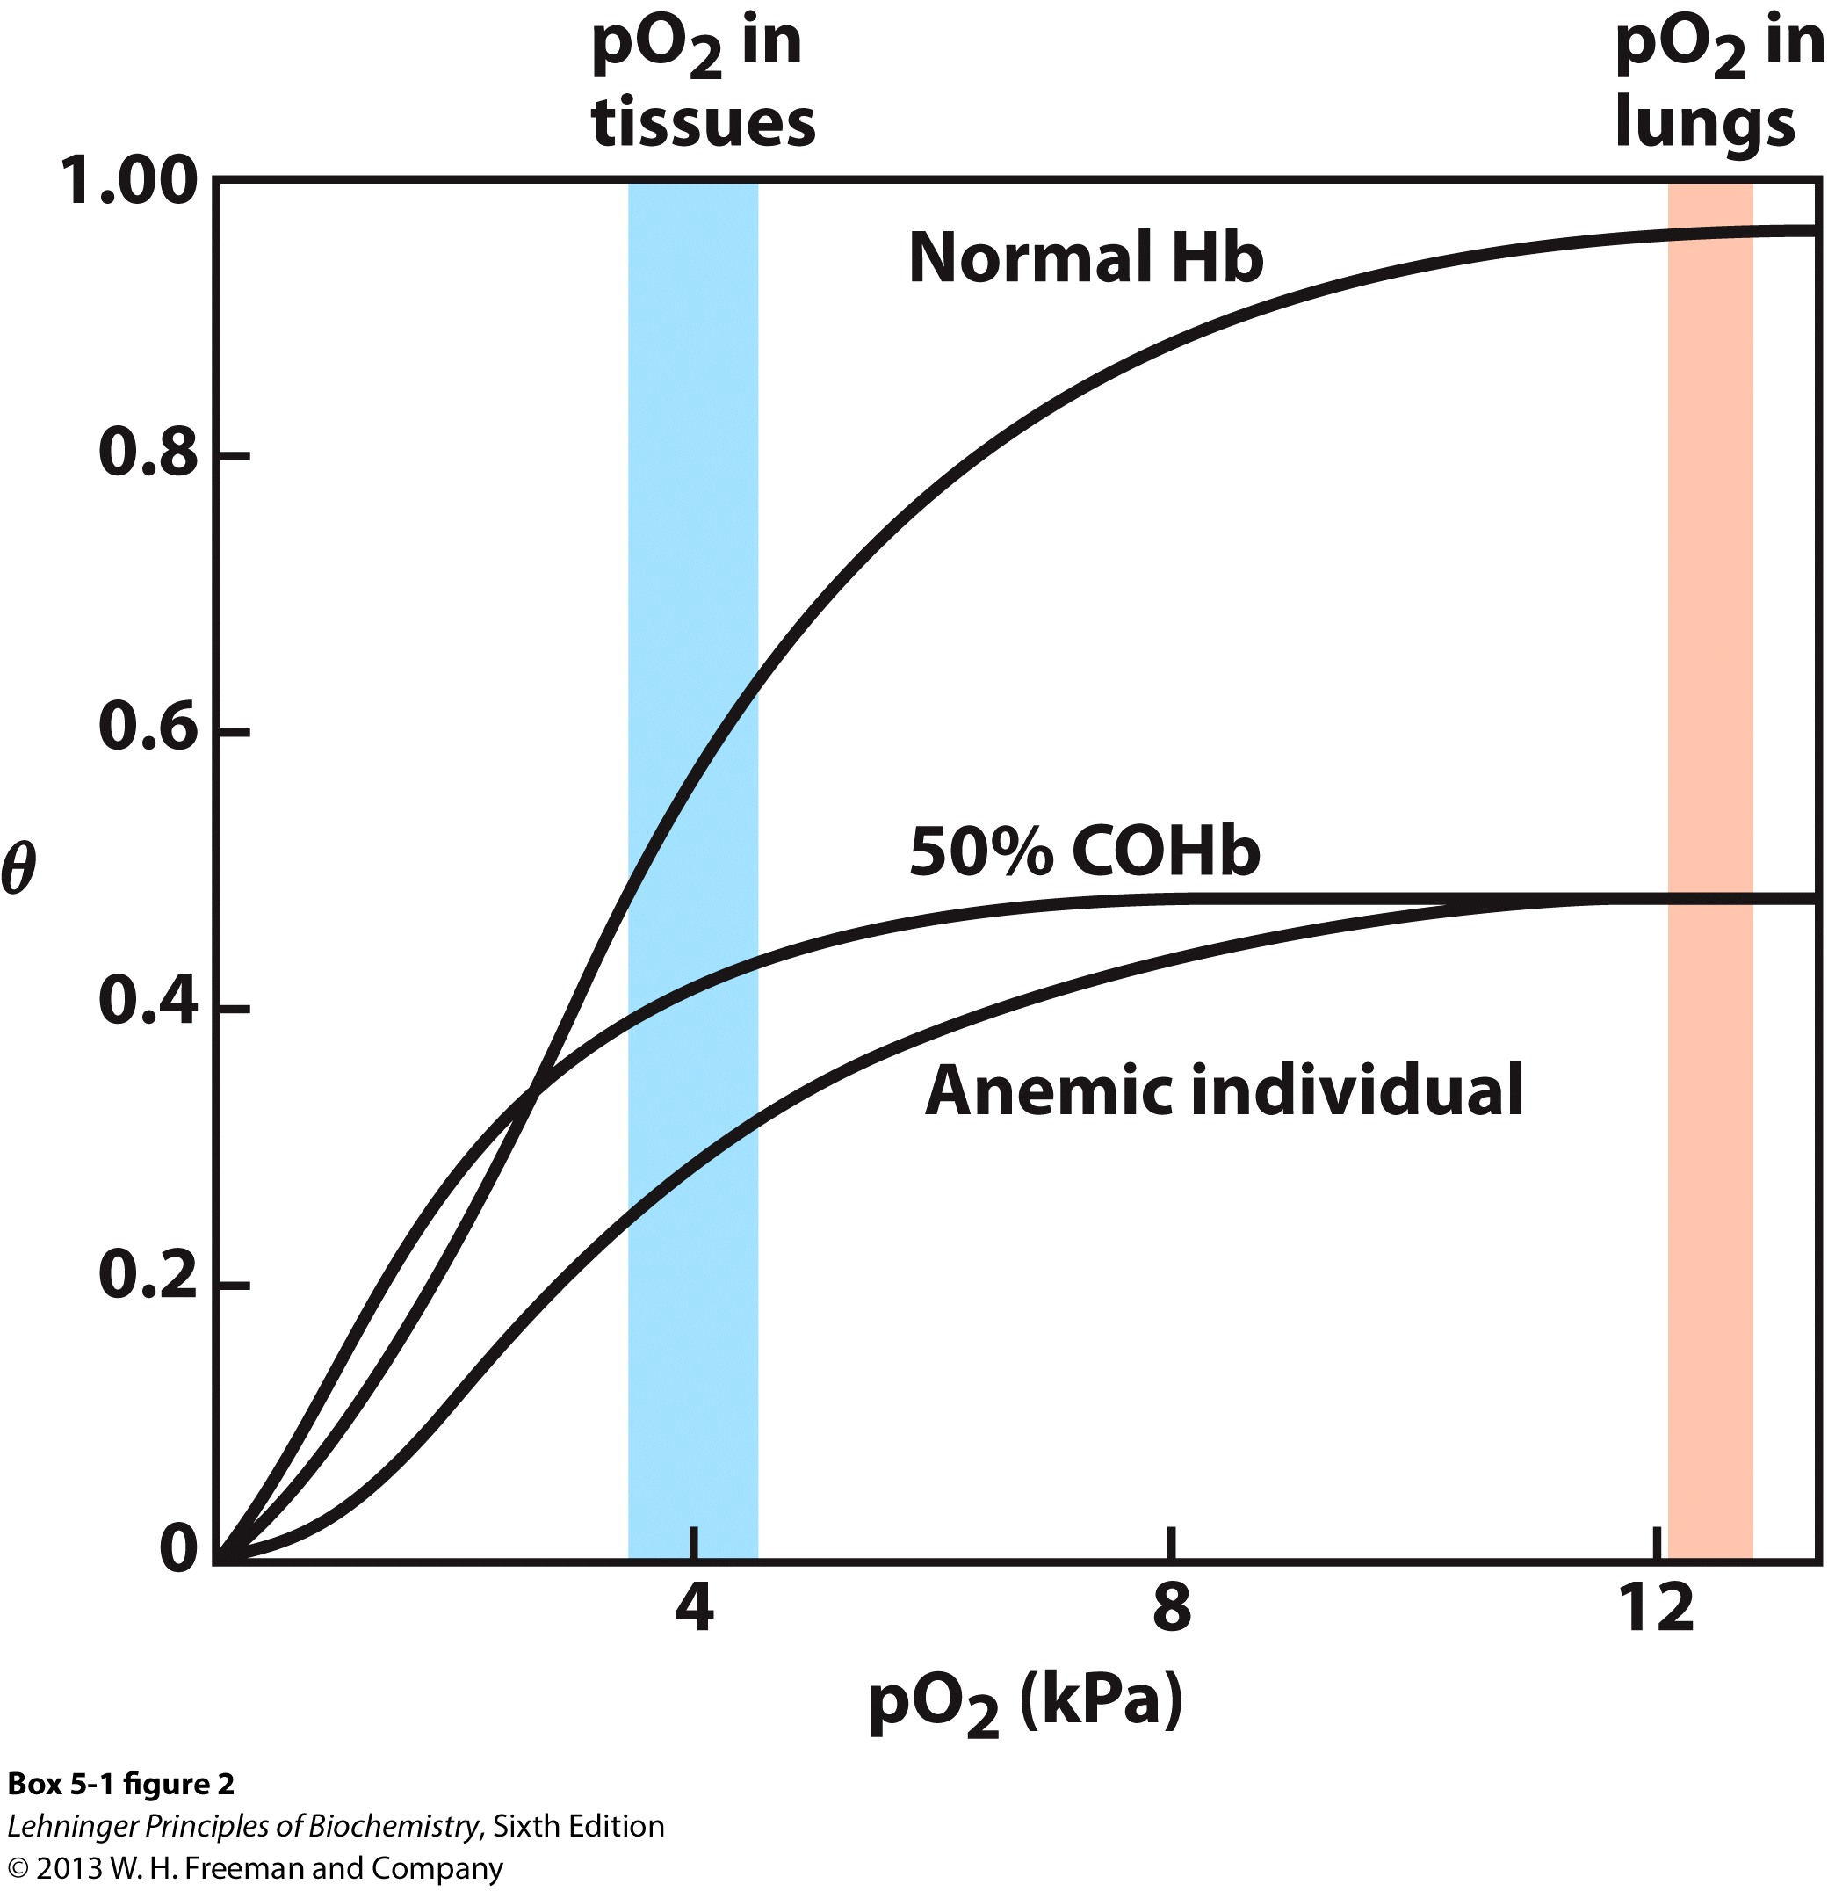
Carbon monoxide poisoning
Carbon monoxide binds so tightly to iron of hemoglobin that it stabilizes the R state to such a degree that the R to T transition does not occur. Peripheral tissues are thus deprived of oxygen.
At 15% of COHb, individuals experience mild headaches. At 25%-30%, more severe symptoms. COHb levels of 50% is lethal.
Health individuals have 1% or less of the total hemoglobin is complexed as COHb. Smokers have COHb levels in the range of 3%-15%.

Slide 34
Sickle-Cell Anemia is a molecular disease of hemoglobin

Slide 35
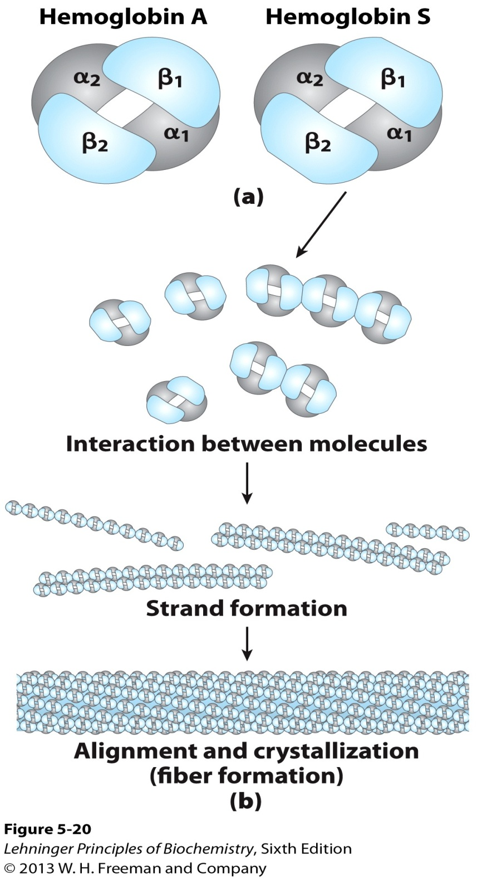
A single amino acid change (Glu⁶ to Val⁶) occurs in the β subunit of hemoglobin, causing the mutant molecule prone to aggregate
Sickled cell are very fragile and rupture easily, resulting in anemia.
Capillaries become blocked by the sickled cells.
Untreated patients die in childhood.
Heterozygous individuals possess a small but significant resistance to lethal forms of malaria.

